Slide 1
Lesson 2: Announcements of the Births of John and Jesus Luke 1

Slide 2
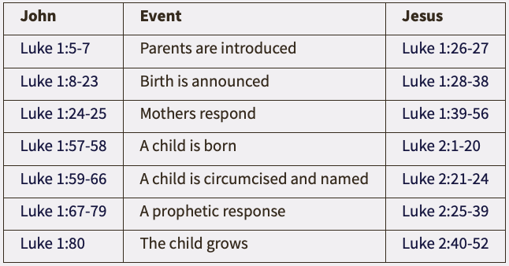
Lesson 2: Announcements of the Births of John and Jesus
Parallels Between John and Jesus
(IVP Dictionary of Jesus and the Gospels – The Gospel of Luke)

Slide 3
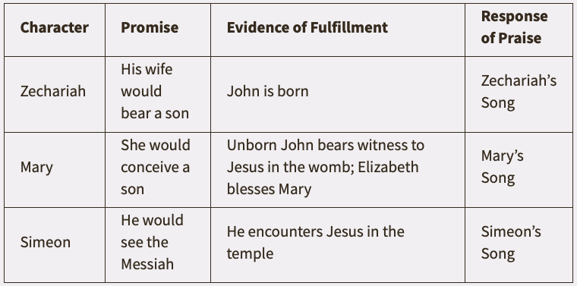
Lesson 2: Announcements of the Births of John and Jesus
Promise, Fulfillment and Praise
(IVP Dictionary of Jesus and the Gospels – The Gospel of Luke)

Slide 4
Lesson 2: Announcements of the Births of John and Jesus
Announcement of the Birth of John (1:5-25)
Character and circumstance of Zacharias and Elizabeth (vv. 5-7).
Zacharias’ priestly service, and appearance of Gabriel with the promise of John’s birth (vv. 8-17).
Zacharias’ reaction, Gabriel’s response, the people’s reaction, and Elizabeth’s response (vv. 18-25).

Slide 5
Lesson 2: Announcements of the Births of John and Jesus
Announcement of the Birth of Jesus (1:26-38)
Mary introduced, and Gabriel appears to her (vv. 26-28).
Gabriel explains his greeting, and reveals the promise of Jesus, and His position (vv. 29-33).
Mary’s perplexity, Gabriel’s explanation and sign of Elizabeth’s pregnancy, and Mary’s response (vv. 34-38).

Slide 6
Lesson 2: Announcements of the Births of John and Jesus
Mary Visits Elizabeth (1:39-56)
Mary visits Elizabeth, and the Holy Spirit causes Elizabeth to speak concerning Mary and her child (vv. 39-45).
Mary’s song (vv. 46-55) – called the “The Magnificat” (Latin for “magnifies” – v. 46)
(vv. 46-48) – Mary magnifies God for what He has done for her.
(vv. 49-50) – Mary’s thoughts extend beyond herself to God’s mercy touching all who fear Him.
(vv. 51-53) – God’s power showing mercy is contrasted with His power showing severity toward those who do not fear Him.
(vv. 54-55) – Mary’s connection that the mercy shown her by God is the fulfillment of His seed promise made to Abraham and the fathers.

Slide 7
Lesson 2: Announcements of the Births of John and Jesus
Mary Visits Elizabeth (1:39-56)
Mary visits Elizabeth, and the Holy Spirit causes Elizabeth to speak concerning Mary and her child (vv. 39-45).
Mary’s song (vv. 46-55) – called the “The Magnificat” (Latin for “magnifies” – v. 46)
Mary stays about three months and returns home (v. 56).

Slide 8
Lesson 2: Announcements of the Births of John and Jesus
The Birth of John (1:57-66)
Elizabeth gives birth, and her neighbors and relatives rejoice with her (vv. 57-58).
Zacharias and Elizabeth take the child to be circumcised, and he is named John, resulting in the discussion of the people (vv. 59-66).

Slide 9
Lesson 2: Announcements of the Births of John and Jesus
Zacharias’ Prophecy (1:67-79)
Zacharias’ words are inspired prophecy (v. 67).
Praise to God for visiting His people with salvation by the Messianic servant of David’s lineage sworn to Abraham (vv. 68-75).
John, Zacharias’ son, will be a prophet of God to bring knowledge of salvation through the Messiah to the people (vv. 76-79).
The Early Life of John (1:80)

