Slide 1
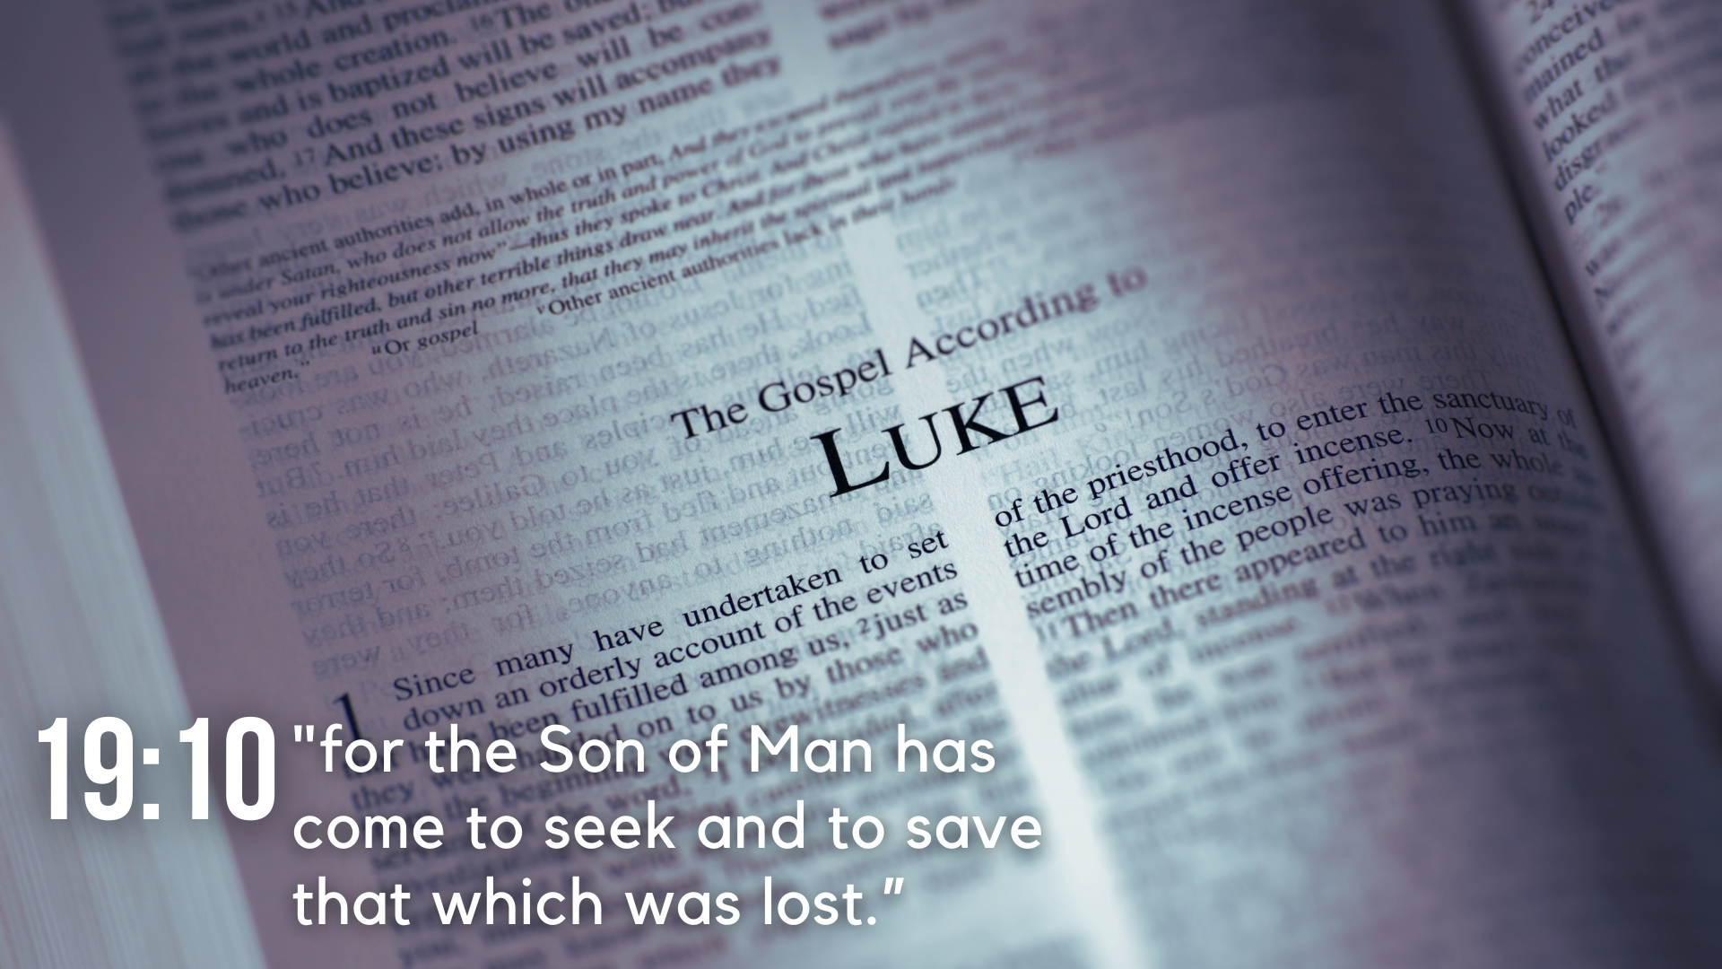
Lesson 7: Controversies on the Sabbath and the Sermon on the Plain
Luke 6

Slide 2
Lesson 7: Controversies on the Sabbath and the Sermon on the Plain
Controversies Regarding the Sabbath (6:1-12)
Jesus is questioned by the Pharisees about His disciples plucking and eating grain on the Sabbath, and He responds (vv. 1-5).
On another Sabbath, Jesus heals a man with a withered hand in the presence of the Pharisees, enraging them against Him (vv. 6-11).

Slide 3
Lesson 7: Controversies on the Sabbath and the Sermon on the Plain
Selection of the Twelve (6:13-17)
Jesus went to a mountain to continue all night in prayer to God (v. 12).
The following day, Jesus chooses twelve from His disciples and names them apostles (vv. 13-16).

Slide 4
Lesson 7: Controversies on the Sabbath and the Sermon on the Plain
Sermon on the Plain (6:17-49)
Jesus came down to a level place on the mountain to a multitude ready to hear Him and be healed by Him. Jesus heals them all (vv. 17-19).
The Beatitudes (vv. 20-26)
  Jesus speaks of the characteristics of those blessed in the kingdom of God (vv. 20-23).
  Jesus pronounces woes upon those who possess opposite characteristics (vv. 24-26).

Slide 5
Lesson 7: Controversies on the Sabbath and the Sermon on the Plain
Sermon on the Plain (6:17-49)
The Beatitudes (vv. 20-26)
Love Your Enemies (vv. 27-36)
  Jesus speaks about proper love for even enemies, and thus negates vengeance (vv. 27-31).
  Jesus calls disciples to love even as the Father loves (vv. 32-36).

Slide 6
Lesson 7: Controversies on the Sabbath and the Sermon on the Plain
Sermon on the Plain (6:17-49)
The Beatitudes (vv. 20-26)
Love Your Enemies (vv. 27-36)
Judging (vv. 37-45)
  Jesus explains that the same measure we use in judgment of others will be returned to us (vv. 37-38).
  Jesus explains that judgment must not lack clarity through poor teaching, and hypocrisy (vv. 39-42).
  Jesus explains the distinction between a good man and an evil man (vv. 43-45).

Slide 7
Lesson 7: Controversies on the Sabbath and the Sermon on the Plain
Sermon on the Plain (6:17-49)
The Beatitudes (vv. 20-26)
Love Your Enemies (vv. 27-36)
Judging (vv. 37-45)
Building on a Solid Foundation (vv. 46-49)
  Jesus indicates inconsistency in calling Him Lord without corresponding obedience (v. 46).
  Jesus uses imagery of builders to encourage His disciples to show wisdom by putting the things they hear from Him into action (vv. 46-49).

