Slide 1
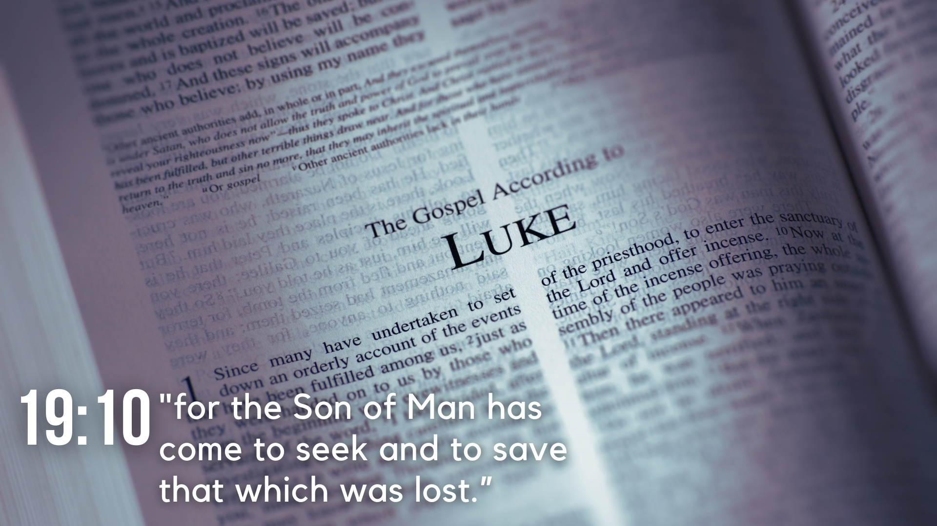
Lesson 9 – The Parable of the Sower and Several Miracles
Luke 8

Slide 2
Lesson 9 – The Parable of the Sower and Several Miracles
The Charitable Women (8:1-3)
Jesus continues to travel, preaching the gospel of the kingdom of God (v. 1a).
The twelve apostles travel with Jesus, as well as several women healed of evil spirits who contribute to Jesus’ ministry (vv. 2b-3).

Slide 3
Lesson 9 – The Parable of the Sower and Several Miracles
The Parable of the Sower (8:4-15)
A multitude gathers to Jesus and He speaks a parable about a sower sowing seed, and the results of various soils (vv. 4-8).
The disciples ask Jesus what the parable means, and Jesus responds (vv. 9-10).
Jesus gives the explanation of the parable of the sower which represents the word being received or rejected by men (vv. 11-15).

Slide 4
Lesson 9 – The Parable of the Sower and Several Miracles
The Light Lit (8:16-18)
Jesus uses a lamp’s purpose to demonstrate His intentions to reveal truth, not to conceal (vv. 16-17).
Based on His intention to reveal, Jesus exhorts His disciples to be careful hearers so that more will be given them (v. 18).
The Mother and Brothers of Jesus (8:19-21)
Jesus’ mother and brothers come to Him, and someone tells Him they are desiring to see Him (vv. 19-20).
He responds by saying His mother and brothers are those who hear and obey God’s word (v. 21).

Slide 5
Lesson 9 – The Parable of the Sower and Several Miracles
Calming the Sea (8:22-25)
Jesus and His disciples get in a boat to cross the lake, and Jesus falls asleep (v. 22).
A storm comes upon them, and being in jeopardy, the disciples awake Jesus (vv. 23-24a).
Jesus causes the storm to cease with His word and admonishes His disciples for lack of faith. They marvel, wondering who He is with such authority (vv. 24b-25).

Slide 6
Lesson 9 – The Parable of the Sower and Several Miracles
Healing the Gadarene Demoniac (8:26-40)
Having reached the country of the Gadarenes, Jesus is met by a man with demons who had suffered a long time (vv. 26-27).
The man cries out to Jesus, confessing His identity, and begging not to be tormented (vv. 28-29).
Jesus asks for his name, he replies, “Legion,” and begs not to be commanded to go into the abyss (vv. 30-31).

Slide 7
Lesson 9 – The Parable of the Sower and Several Miracles
Healing the Gadarene Demoniac (8:26-40)
Jesus permits the demons to enter a herd of swine per their request, and the swine run down to the sea and drown (vv. 32-33).
News reaches the city and country, and Jesus is asked to depart due to the fear of the people (vv. 34-37).
The man who had the demons asks to go with Jesus, but He tells him to go tell of the event to others (vv. 38-39).

Slide 8
Lesson 9 – The Parable of the Sower and Several Miracles
Healing the Woman with an Issue of Blood and Raising Jairus’ Daughter (8:41-56)
A multitude welcomes Jesus upon His return, and the synagogue ruler, Jairus, falls at Jesus’ feet and begs Him to come heal his dying daughter (vv. 40-42).
The crowd throngs Jesus on the way, and a woman with a flow of blood for twelve years touches His garment and is healed (vv. 43-44).
Jesus asks who touched Him, and the woman is revealed. Jesus encourages her (vv. 45-48).

Slide 9
Lesson 9 – The Parable of the Sower and Several Miracles
Healing the Woman with an Issue of Blood and Raising Jairus’ Daughter (8:41-56)
Jairus is informed of his daughter’s death, Jesus overhears, and reassures Him that she will be made well if he believes (vv. 49-50).
Jesus goes into the house and raises the girl from the dead, causing the parents to be astonished (vv. 51-56).

