Slide 1
Lesson 20 Luke 19

Slide 2
Jesus Meeting with Zacchaeus
Luke 19:1-10
Zacchaeus
A Rich Publican. a person of importance, a Jew
He had a desire to see Jesus
Jesus saw Zacchaeus’s heart and soul and what is needed
The multitude murmured when Jesus went to his house
Zacchaeus repented and was willing to make things right
Jesus knew his penitence and then stated salvation has come to this house
Jesus mission was to seek and save the lost.

Slide 3
The Parable of the Pounds
Luke 19:11-27
Jesus realized he was getting nearer to Jerusalem
The multitude was expecting the establishment of an earthly kingdom to occur at that time.
Jesus told this parable to attempt to offset the anticipation.
We need careful not to neglect the trust that is given to us.
Our reward of heaven depends upon our use of our gift of salvation

Slide 4
The Triumphant Entry of Jesus in Jerusalem
Luke 19:29 - 40
Jesus knew about the prophecy of his entry to Jerusalem in Zachariah 9:9.
The whole multitude of the disciples began to rejoice and praise God with a loud voice for all the mighty works they had seen
This served to bring His claim prominently before the people of Jerusalem
The Pharisees tried to stop them and rebuked him because
They feared the Romans would interpret this as a rebellion.
They took offense at the application to Jesus of the prophetic words which could only be used in reference to the Messiah. Luke 19:38

Slide 5
Weeping over Jerusalem
Luke 19:41 - 44
The city of Jerusalem was right in front of Him and when he saw their guilt and future ruin it gave occasion for Him to weep and moan over it

Slide 6
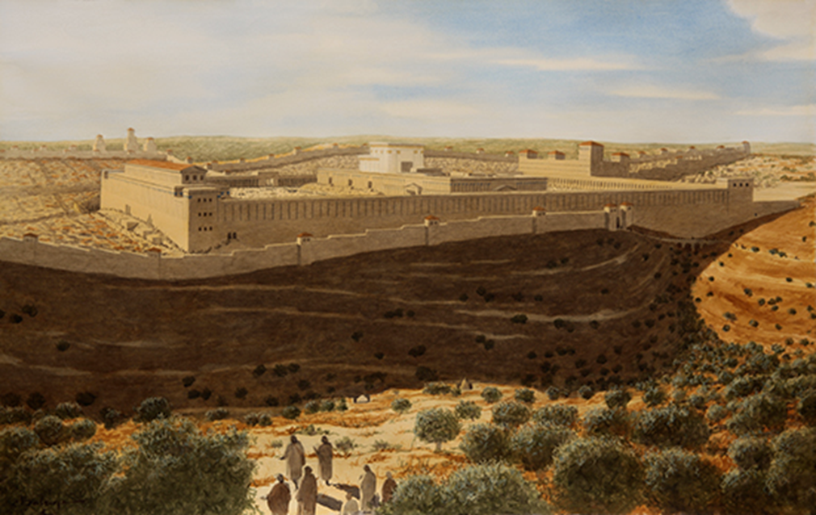
Weeping over Jerusalem
The view that Jesus might have seen when He was approaching the city.

Slide 7
Weeping over Jerusalem
Luke 19:41 - 44
The city of Jerusalem was right in front of Him and when he saw their guilt and future ruin it gave occasion for Him to weep and moan over it
Their prejudice, ignorance, their unbelief had blinded their eyes and as a result they rejected Jesus and the Messiah.
Jesus predicts that the city will be leveled to the ground. Not one stone upon the other.

Slide 8
Jesus Cleansing the Temple
Luke 19:45 - 48
Jesus cleansed the temple the day after he arrived in Jerusalem
Jesus threw them out because the people were conducting business for a profit at the expense of the people.
Jesus said that the temple, “House of Prayer” they had made “a den of thieves”
The Jewish chief priests, scribes and leaders sought to destroy Him.
They feared Him because the people were very attentive to hear Him
Mark 11:18 states that feared Him because the people were astonished at His teaching

