Slide 1
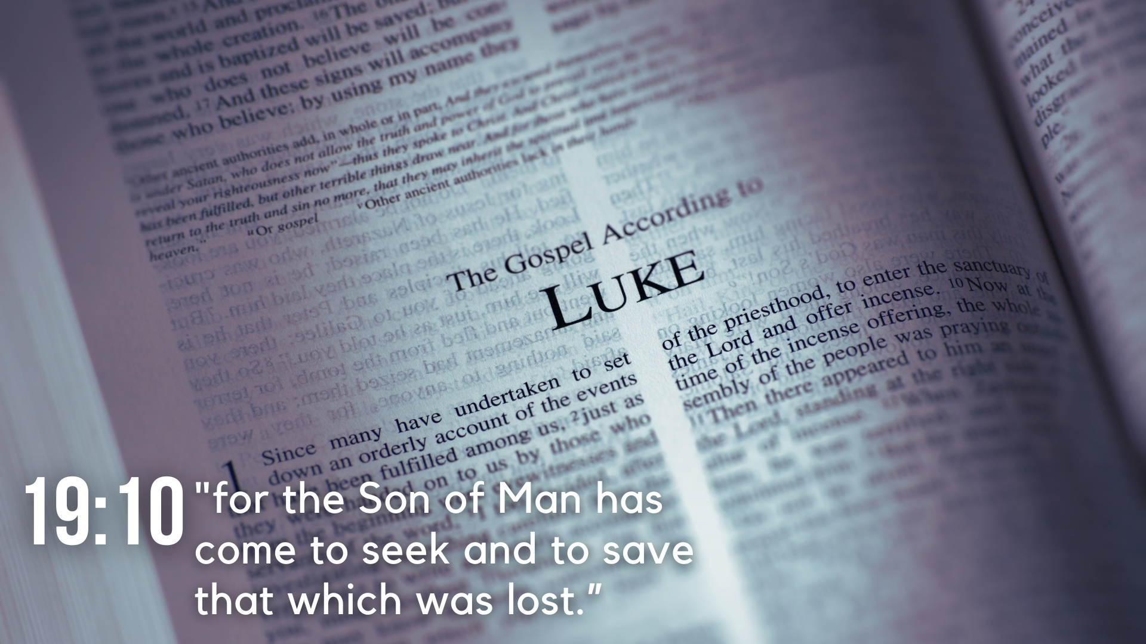
Lesson 21 – Confrontations in the Temple
Luke 20

Slide 2
Lesson 21 – Confrontations in the Temple
Challenging Jesus’ Authority (20:1-8)
Jesus is in the temple preaching and the Jewish leaders confront Him with a question about His authority for what He is doing (vv. 1-2).
Jesus replies with a question of His own concerning the authority for John’s baptism – from heaven or men? (vv. 3-4).
Perceiving a problem for themselves with either answer, they plead ignorance (vv. 5-7).
Jesus tells them He will then neither answer them concerning the source of His authority (v. 8).

Slide 3
Lesson 21 – Confrontations in the Temple
Jesus’ Parable of the Vineyard (20:9-18)
Jesus tells the people a parable about a man’s vineyard he leased to vinedressers who beat and sent away three servants he sent to receive fruit from his vineyard (vv. 9-12).
The owner reasoned about his next action, and determining that they would respect his son, sent him, though they saw him, conspired against him to take his inheritance, and killed him (vv. 13-15a).

Slide 4
Lesson 21 – Confrontations in the Temple
Jesus’ Parable of the Vineyard (20:9-18)
Jesus asks what the owner will do to the vinedressers and says he will destroy them and give the vineyard to others (vv. 15b-16).
He quotes Psalm 118:22 and explains that the stone therein will break those who fall on it, and grind to powder those on whom it falls (vv. 17-18).
The Jewish leaders seek to take Him, but do not for fear of the people (v. 19).

Slide 5
Lesson 21 – Confrontations in the Temple
Question about Paying Taxes (20:19-26)
The Jewish leaders send spies to Jesus to catch Him in an error, and they ask Him about whether it is lawful to pay taxes to Caesar (vv. 20-22).
Jesus expresses His knowledge of their motives, points out that Caesar’s image and inscription is on a denarius, and says to render to Caesar his things, and God’s His things (vv. 23-25).
The Jewish leaders could not catch Him but marveled at His answer (v. 26).

Slide 6
Lesson 21 – Confrontations in the Temple
Question about the Resurrection (20:27-38)
The Sadducees who deny a resurrection ask Him a question concerning levirate marriage as prescribed in the Law of Moses (vv. 27-28).
Their question centered on a hypothetical concerning seven brothers, the first of which took a wife and died before having children, and each successive brother marrying his wife and dying before having children, then the woman died (vv. 29-32).
They ask whose wife will she be in the resurrection, supposing to have found a problem with the resurrection doctrine (v. 33).

Slide 7
Lesson 21 – Confrontations in the Temple
Question about the Resurrection (20:27-38)
Jesus explains to them that marriage is a matter for those of this age, but those who attain to the age of the resurrection have nothing to do with marriage, and neither do they die (vv. 34-36).
He further explains that Moses necessarily implied the truth of the resurrection in the “burning bush passage,” showing God is of the living, not the dead (vv. 37-38).
Some scribes tell Him He had spoken well, and none question Him anymore (vv. 39-40).

Slide 8
Lesson 21 – Confrontations in the Temple
Jesus Questioned His Critics (20:41-44)
Jesus asks them how they can say the Christ is David’s Son (v. 41).
He quotes Psalm 110:1 and asks how the Christ is a Son if David calls Him Lord (vv. 42-44).

Slide 9
Lesson 21 – Confrontations in the Temple
Jesus’ Criticism of the Jewish Leaders (20:45-47)
Jesus warns of the scribes’ selfish desire for preeminence, and to be seen of men (vv. 45-46).
He exposes their true character in devouring widows’ houses, and making long prayers in pretense, explaining they will receive the greater condemnation (v. 47).

