Slide 1
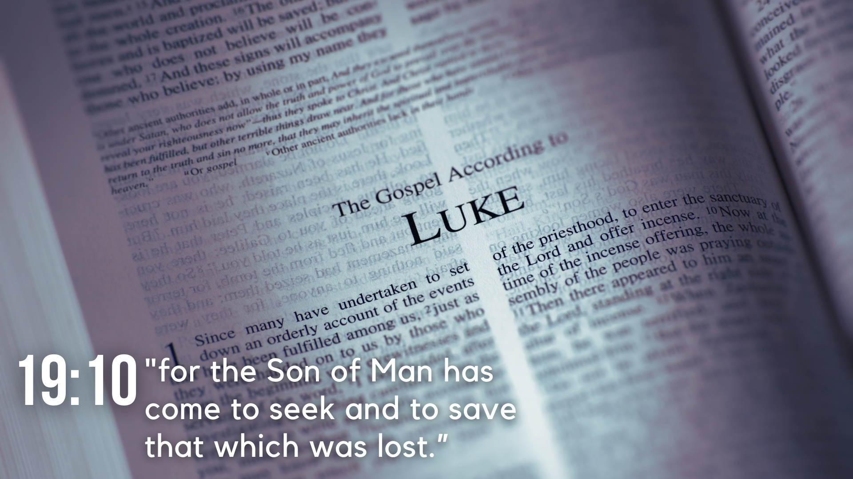
Lesson 23 – Events Leading to the Arrest and Trial of Jesus – Luke 22

Slide 2
Lesson 23 – Events Leading to the Arrest and Trial of Jesus
Judas’ Conspiracy with the Priests (22:1-6)
As Passover draws near, the Jewish leaders seek how they might kill Jesus (vv. 1-2).
Satan enters Judas Iscariot, he confers with the Jewish leaders, and they offer him money to betray Jesus (vv. 3-6).

Slide 3
Lesson 23 – Events Leading to the Arrest and Trial of Jesus
Preparation for Passover (22:7-13)
Jesus sends Peter and John to prepare the Passover for them to eat (vv. 7-8).
They ask Jesus where, and He gives them specific instructions concerning a man they would see in the city, a house he would enter, and a furnished upper room (vv. 9-13).

Slide 4
Lesson 23 – Events Leading to the Arrest and Trial of Jesus
Institution of the Lord’s Supper (22:14-23)
Jesus sits with the twelve apostles and expresses His great desire to eat the Passover with them, and that He would not eat it again until its fulfillment in the kingdom (vv. 14-16).
Jesus takes the fruit of the vine and the bread, explains them as emblems of His body and blood, and institutes the Lord’s Supper (vv. 17-20).
He then indicates His betrayer is among them, and they question about who would betray Him (vv. 21-23).

Slide 5
Lesson 23 – Events Leading to the Arrest and Trial of Jesus
Dispute about Greatness (22:24-30)
A dispute arises among the disciples about who would be the greatest (v. 24).
Jesus contrasts the idea of greatness among the Gentiles with the greatness of servitude among the disciples (vv. 25-26).
Jesus uses Himself as an example of greatness in service (v. 27).
He tells the apostles that He would bestow on them a kingdom where they will eat and drink at His table and sit on thrones judging Israel (vv. 28-30).

Slide 6
Lesson 23 – Events Leading to the Arrest and Trial of Jesus
Jesus Foretold Peter’s Denial (22:31-34)
Jesus tells Simon about Satan’s request to sift the disciples, and that He has prayed for His faith (vv. 31-32).
Simon expresses his willingness to die for Jesus, and He responds by foretelling Peter’s denial of Him (vv. 33-34).

Slide 7
Lesson 23 – Events Leading to the Arrest and Trial of Jesus
Jesus’ Commission Requires Preparation for Protection (22:35-38)
Jesus asks if they lacked anything after His instruction in the limited commission, and they tell Him they lacked nothing (v. 35).
He tells them to do the opposite of what He told them then, and to secure a sword (v. 36).
He tells them what was written of Him being numbered with transgressors must be accomplished (v. 37).
They tell Jesus they have two swords, and Jesus says, “It is enough.” (v. 38)

Slide 8
Lesson 23 – Events Leading to the Arrest and Trial of Jesus
Jesus’ Prayer in Gethsemane (22:39-46)
Jesus and the apostles go to the Mount of Olives, and He instructs them to pray (vv. 39-40).
Jesus withdraws from the disciples and prays to the Father that the cup pass from Him, but that the Father’s will be done (vv. 41-42).
An angel comes and strengthens Jesus, and He prays more earnestly, being in agony (vv. 43-44).
Jesus rises from prayer, finds the disciples sleeping, and admonishes them (vv. 45-46).

Slide 9
Lesson 23 – Events Leading to the Arrest and Trial of Jesus
Betrayal and Arrest (22:47-53)
Judas leads a multitude to Jesus, draws near to kiss Him, and Jesus asks him if he is betraying Him with a kiss (vv. 47-48).
The disciples ask Jesus whether they should strike with the sword, and one of them cuts off the servant of the high priest’s ear (vv. 49-50).
Jesus tells them to permit it, heals the man, and tells the multitude they come to Him as if He were a robber even though they never tried to take Him in the temple (vv. 51-53).

Slide 10
Lesson 23 – Events Leading to the Arrest and Trial of Jesus
Peter’s Denial of Jesus (22:54-62)
Peter follows at a distance as Jesus is brought to the high priest’s house (v. 54).
Peter sits among some in the courtyard, and when some identify him as being a companion of Jesus, he denies it three times, and a rooster crows (vv. 55-60).
The Lord looks at Peter, and Peter remembers what He said about denying Him, and he weeps bitterly (vv. 61-62).

Slide 11
Lesson 23 – Events Leading to the Arrest and Trial of Jesus
Trial before the Council (22:63-71)
Those who hold Jesus beat Him, mock Him, and blasphemously speak against Him (vv. 63-65).
At day, the Jewish leaders lead Him into their council, and ask if He is the Christ (vv. 66-67a).
Jesus says they will not believe, nor will they answer His questions, but after they would see the Son of man sit on the right hand of the power of God (vv. 67b-69).
They ask Him if He is the Son of God, He says He is, and they reason they need no more testimony (vv. 70-71).

