Slide 1
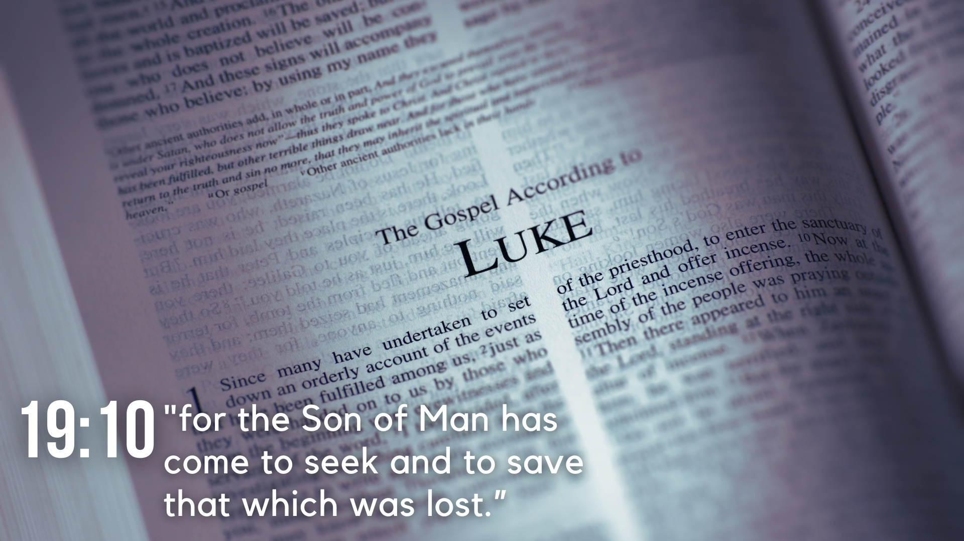
Lesson 25 – The Resurrection Appearances – Luke 24

Slide 2
Lesson 25 – The Resurrection Appearances
The Resurrection and Appearance to the Women (24:1-12)
Female disciples of Jesus come to the tomb on the first day of the week to anoint His body with spices but find the tomb open and empty (vv. 1-3).
Two men appear in shining garments and ask why the women seek the living among the dead and remind them of Jesus’ words concerning His resurrection (vv. 4-8).

Slide 3
Lesson 25 – The Resurrection Appearances
The Resurrection and Appearance to the Women (24:1-12)
The women return to the apostles and other disciples to tell them what happened (vv. 9-10).
They do not believe them, but Peter runs to the empty tomb and marvels about what had happened (vv. 11-12).

Slide 4
Lesson 25 – The Resurrection Appearances
Appearance to the Two on the Road to Emmaus (24:13-35)
Two disciples are traveling to Emmaus and conversing about the recent events in Jerusalem when Jesus draws near, though their eyes are kept from recognizing Him (vv. 13-16).
Jesus asks them what they are talking about, and they are surprised that He is not aware of the recent events (vv. 17-19a).
They tell Him about Jesus of Nazareth, a Prophet of God that was condemned and crucified by the Jewish rulers, who they hoped to be the redeemer of Israel (vv. 19b-21).

Slide 5
Lesson 25 – The Resurrection Appearances
Appearance to the Two on the Road to Emmaus (24:13-35)
They tell Him about the women who found the empty tomb, about the angels who said He was alive, and how they went and saw the tomb themselves (vv. 22-24).
Jesus reproves them for their slowness to believe what the prophets spoke concerning the Christ’s suffering and glorification, and then He expounds such things to them in the Scriptures (vv. 25-27).

Slide 6
Lesson 25 – The Resurrection Appearances
Appearance to the Two on the Road to Emmaus (24:13-35)
The disciples compel Jesus to stay with them, and their eyes are opened to know Him, and He vanishes from their sight (vv. 28-31)
They recall how they were affected as He spoke to them on the road and return to Jerusalem to tell the apostles and other disciples, noting Jesus’ appearance to Simon, and what had happened on the road and when Jesus ate with them (vv. 32-35).

Slide 7
Lesson 25 – The Resurrection Appearances
Appearance to the Apostles (24:36-43)
Jesus appears to the disciples as the two gave the report, and all are afraid (vv. 36-37).
Jesus asks them about their fear and doubt and shows them His hands and feet to confirm it is Himself, and not a spirit (vv. 38-40).
They still do not believe for joy, so Jesus asks for food, and He eats in their presence (vv. 41-43).

Slide 8
Lesson 25 – The Resurrection Appearances
Christ’s Final Appearance and Ascension (24:44-53)
Jesus reminds them of what He spoke concerning Himself during His ministry about what must be fulfilled from the Old Law and opens their understanding (vv. 44-45).
He tells them His suffering and resurrection were necessary, and that the preaching of repentance and remission of sins to all nations must begin at Jerusalem (vv. 46-47).

Slide 9
Lesson 25 – The Resurrection Appearances
Christ’s Final Appearance and Ascension (24:44-53)
He explains that they are witnesses, and that He will send the Promise of His Father on them, and they are to wait in Jerusalem until they are endued with power (vv. 48-49).
Jesus blesses them and is carried up into heaven. They worship Him, return to Jerusalem, and continue in the temple praising and blessing God (vv. 50-53).

