Slide 1
ACTS
DONNIE V. RADER

Slide 2
Introduction

Slide 3
Acts
Introduction

Slide 4
Introduction to Acts
The Author
Luke
Author of the gospel of Luke
Refers to the “former account” written to Theophilus (Acts 1:1)
Early writers (Irenaeus, Clement of Alexandria and Tertullius) credit Luke
Was a close associate with Paul (“we” in Acts 16:10; 20:6)
What do we know about Luke?
Only three references to him (Col. 4:14; Philemon 24; 2 Tim. 4:11).
Physician (Col. 4:14)
Only Gentile writer of NT (Col. 4:11-12, 14)

Slide 5
Introduction to Acts
The Author
The Recipient of the Book
Theophilus (Acts 1:1)
One to whom book of Luke was written (Luke 1:3)
Possibly a high official in Roman government (Luke 1:3)
Name means “lover of God”

Slide 6
Introduction to the Book of Acts
The Author
The Recipient of the Book
When Was the Book Written?
Paul was in Rome in prison (61-63 AD) – could not be written before then
Acts covers about 30 years (33 AD to 63 AD)

Slide 7
Introduction to Acts
The Author
The Recipient of the Book
When Was the Book Written?
The Value of the Book of Acts
Without it we would have no information on the early church
The book provides a bridge between the gospels and the epistles
Without it we would have two disjointed fragments
With it we have a background against which the epistles can be better understood
Acts gives us an accurate history

Slide 8
Introduction to Acts
The Author
The Recipient of the Book
When Was the Book Written?
The Value of the Book of Acts
Theme and Contents
The spread of the gospel from Jerusalem to all of the world
Two focal points:
Chapters 1-12 – gospel to the Jews
Chapters 13-18 – gospel to the Gentiles
Book of conversions (and non-conversions)
A summary history

Slide 9
Six Panels
Each ending with a progress report
1:1 – 6:7
6:8 – 9:31
9:32 – 12:24
12:25 – 16:5
16:6 – 19:20
19:21 – 28:31

Slide 10
Introduction to Acts
The Author
The Recipient of the Book
When Was the Book Written?
The Value of the Book of Acts
Theme and Contents
Outline of the Book

Slide 11
From Jerusalem to All the World
The Gospel in Palestine (1-12)
The Gospel to the Uttermost Parts of the World (13-28)

Slide 12
From Jerusalem to All the World
The Gospel in Palestine (1-12)
In Jerusalem (1-7)
Preparing the apostles for their work (1)
The beginning of the gospel (2)
Opposition and persecution (3-7)
In Judea and Samaria (8-12)
Conversions (8-11)
Samaritans and Simon (8)
Eunuch (8)
Saul (9)
Cornelius (10-11)
Establishment of the church at Antioch (11)
Herod persecutes the church (12)

Slide 13
From Jerusalem to All the World
The Gospel in Palestine (1-12)
The Gospel to the Uttermost Parts of the World (13-28)
The first missionary journey (13-14)
The Jerusalem discussion about circumcision (15)
The second missionary journey (16-18)
The third missionary journey (19-20)
Paul’s trials and journey to Rome (21-28)

Slide 14
Lesson 1
Acts 1

Slide 15
Lesson 1 - Acts 1
Preparing the Apostles for Their Work
The Promise of the Spirit (vv. 1-8)
The Ascension (vv. 9-11)
The Appointment of Matthias (vv. 12-26)

Slide 16
Lesson 1 - Acts 1
Preparing the Apostles for Their Work
The Promise of the Spirit (vv. 1-8)
Luke connects this to his first book (vv. 1-2)
Jesus gives instructions to the Apostles after his resurrection (vv. 3-8)
Was with them forty days (v. 3)
Presented himself alive by many infallible proofs
Spoke of things pertaining to kingdom of God

Slide 17
Lesson 1 - Acts 1
Preparing the Apostles for Their Work
The Promise of the Spirit (vv. 1-8)
Luke connects this to his first book (vv. 1-2)
Jesus gives instructions to the Apostles after his resurrection (vv. 3-8)
Wait in Jerusalem for the promise of the Spirit (vv. 4-5)
Shall be witnesses (vv. 6-8)
In Jerusalem
In Judea and Samaria
Uttermost parts of the earth

Slide 18
Lesson 1 - Acts 1
Preparing the Apostles for Their Work
The Promise of the Spirit (vv. 1-8)
The Ascension (vv. 9-11)
Jesus taken up out of their sight (v. 9)
The promise of his return (vv. 10-11)

Slide 19
Lesson 1 - Acts 1
Preparing the Apostles for Their Work
The Promise of the Spirit (vv. 1-8)
The Ascension (vv. 9-11)
The Appointment of Matthias (vv. 12-26)
Prayer in the upper room in Jerusalem (vv. 12-14)
Peter speaks concerning Judas and selecting a new apostle (vv. 15-22)
The fall of Judas (vv. 15-20)
Qualifications for a new apostle (vv. 21-22)
They chose Matthias (vv. 23-26)

Slide 20
Lesson 2
Acts 2

Slide 21
Lesson 2 - Acts 2
The Beginning
The Reception of the Holy Spirit (vv. 1-13)
Peter’s Sermon (vv. 14-36)
Response of the Multitude (vv. 37-41)
The Disciples Continued in the Apostles Doctrine (vv. 42-47)

Slide 22
Lesson 2 - Acts 2
The Beginning
The Reception of the Holy Spirit (vv. 1-13)
A. The apostles receive the Spirit and speak in tongues (vv. 1-4)
B. The multitude is amazed (vv. 5-13)

Slide 23
Lesson 2 - Acts 2
The Beginning
The Reception of the Holy Spirit (vv. 1-13)
Peter’s Sermon (vv. 14-36)
Explanation of the events (vv. 14-21)
Jesus is raised from the dead (vv. 22-36)
The one you crucified is raised (vv. 22-24)
David prophesied of this (vv. 25-31)
He is now exalted as both Lord and Christ (vv. 32-36)

Slide 24
Lesson 2 - Acts 2
The Beginning
The Reception of the Holy Spirit (vv. 1-13)
Peter’s Sermon (vv. 14-36)
Response of the Multitude (vv. 37-41)
They asked what to do (vv. 37-40)
The question (v. 37)
The answer (vv. 38-40)
Repent and be baptized for the remission of sins (vv. 38-39)
Save yourself (v. 40)
They gladly received the word and obeyed (v. 41)

Slide 25
Lesson 2 - Acts 2
The Beginning
The Reception of the Holy Spirit (vv. 1-13)
Peter’s Sermon (vv. 14-36)
Response of the Multitude (vv. 37-41)
The Disciples Continued in the Apostles Doctrine (vv. 42-47)
Followed the apostles’ authority (v. 42)
Were steadfast (v. 42)
Worshiped (v. 42)

Slide 26
Lesson 2 - Acts 2
The Beginning
The Reception of the Holy Spirit (vv. 1-13)
Peter’s Sermon (vv. 14-36)
Response of the Multitude (vv. 37-41)
The Disciples Continued in the Apostles Doctrine (vv. 42-47)
Feared (v. 43)
Took care of the needy (vv. 44-45)
Served daily (v. 46)
Grew (v. 47)

Slide 27
Lesson 3
Acts 3

Slide 28
Lesson 3 - Acts 3
Healing of the Lame Man & Sermon on Christ
Healing of the Lame Man (vv. 1-11)
Peter’s Sermon about Jesus (vv. 12-26)

Slide 29
Lesson 3 - Acts 3
Healing of the Lame Man & Sermon on Christ
Healing of the Lame Man (vv. 1-11)
The lame man expected money from Peter and John (vv. 1-5)
Peter heals the lame man (vv. 6-8)
The people who saw it were amazed (vv. 9-11)

Slide 30
Lesson 3 - Acts 3
Healing of the Lame Man & Sermon on Christ
Healing of the Lame Man (vv. 1-11)
Peter’s Sermon about Jesus (vv. 12-26)
Jesus: The suffering servant (vv. 12-21)
Jesus: the prophet of prophecy (vv. 22-24)
Jesus: the seed of Abraham (vv. 25-26)

Slide 31
Lesson 3 - Acts 3
Healing of the Lame Man & Sermon on Christ
Healing of the Lame Man (vv. 1-11)
Peter’s Sermon about Jesus (vv. 12-26)
Jesus: The suffering servant (vv. 12-21)
This miracle was not by our own power (v. 12)
You killed God’s servant (vv. 13-15a, 17-18)
You denied the Holy One and released a murderer (vv. 13-14)
You killed the prince of life (v. 15)
Through your ignorance (v. 17)
Foretold by the prophets that he must suffer (v. 18)

Slide 32
Lesson 3 - Acts 3
Healing of the Lame Man & Sermon on Christ
Healing of the Lame Man (vv. 1-11)
Peter’s Sermon about Jesus (vv. 12-26)
Jesus: The suffering servant (vv. 12-21)
God raised him up (v. 15b)
Through Christ – this lame man is healed (v. 16)
Therefore, repent and be converted (vv. 19-21)

Slide 33
Lesson 3 - Acts 3
Healing of the Lame Man & Sermon on Christ
Healing of the Lame Man (vv. 1-11)
Peter’s Sermon about Jesus (vv. 12-26)
Jesus: The suffering servant (vv. 12-21)
Jesus: the prophet of prophecy (vv. 22-24)
Moses (vv. 22-23)
God would raise up a prophet like him (v. 22)
If don’t hear him – you will be destroyed (v. 23)
Samuel and others (v. 24)

Slide 34
Lesson 3 - Acts 3
Healing of the Lame Man & Sermon on Christ
Healing of the Lame Man (vv. 1-11)
Peter’s Sermon about Jesus (vv. 12-26)
Jesus: The suffering servant (vv. 12-21)
Jesus: the prophet of prophecy (vv. 22-24)
Jesus: the seed of Abraham (vv. 25-26)
The promise to Abraham (v. 25)
God raised up Christ to bless you in turning you away from sin (v. 26)

Slide 35
Lesson 4
Acts 4

Slide 36
Lesson 4 - Acts 4
Peter and John Before the Council
Peter and John Questioned by the Council (vv. 1-22)
Reaction of the Disciples (vv. 23-31)
The Commitment of the Disciples (vv. 32-37)

Slide 37
Lesson 4 - Acts 4
Peter and John Before the Council
Peter and John Questioned by the Council (vv. 1-22)
Arrested (vv. 1-4)
Because they preached the resurrection (vv. 1-3)
Yet, many believed and obeyed (v. 4)

Slide 38
Lesson 4 - Acts 4
Peter and John Before the Council
Peter and John Questioned by the Council (vv. 1-22)
Questioned (vv. 5-12)
Question: By what power or name was this done (vv. 5-7)?
Answer: By Jesus Christ (vv. 8-12)
Man is healed by the name of Christ who was crucified and raised (vv. 8-10)
He is the rejected stone that became the chief cornerstone (v. 11)
No salvation in any other name (v. 12)

Slide 39
Lesson 4 - Acts 4
Peter and John Before the Council
Peter and John Questioned by the Council (vv. 1-22)
Reaction of the council (vv. 13-22)
Marveled (v. 13a)
Realized that Peter and John had been with Jesus (v. 13b)
Admitted that a miracle had been performed (vv. 14-16)

Slide 40
Lesson 4 - Acts 4
Peter and John Before the Council
Peter and John Questioned by the Council (vv. 1-22)
Reaction of the council (vv. 13-22)
Threatened Peter and John (vv. 17-22)
Commanded them not to speak in the name of Jesus (vv. 17-18)
Peter and John said they could not but speak the things they saw and heard (vv. 19-20)
Let them go after more threats (vv. 21-22)

Slide 41
Lesson 4 - Acts 4
Peter and John Before the Council
Peter and John Questioned by the Council (vv. 1-22)
Reaction of the Disciples (vv. 23-31)
Peter and John report to the disciples (v. 23)
The disciples pray for boldness (vv. 24-30)
The results of the prayer (v. 31)
Place shook
Filled with Spirit
Spoke the word with boldness

Slide 42
Lesson 4 - Acts 4
Peter and John Before the Council
Peter and John Questioned by the Council (vv. 1-22)
Reaction of the Disciples (vv. 23-31)
The Commitment of the Disciples (vv. 32-37)
To unity (v. 32a)
To one another [benevolence] (vv. 32b, 34-37)
To the proclamation of the gospel (v. 33)

Slide 43
Lesson 5
Acts 5

Slide 44
Lesson 5 - Acts 5
The Apostles Imprisoned and Beaten But Keep on Preaching
Ananias and Sapphira Lie and Are Punished (vv. 1-11)
The Apostles Perform Miracles (vv. 12-16)
Apostles Imprisoned, Questioned and Beaten (vv. 17-40)
Apostles Continue to Preach Christ (vv. 41-42)

Slide 45
Lesson 5 - Acts 5
The Apostles Imprisoned and Beaten But Keep on Preaching
Ananias and Sapphira Lie and Are Punished (vv. 1-11)
Kept part of the money they claimed to give (vv. 1-2)
Peter Rebuked them for lying and they fell dead (vv. 3-10)
Ananias (vv. 3-6)
Sapphira (vv. 7-10)
Their punishment caused the church and others to fear (v. 11)

Slide 46
Lesson 5 - Acts 5
The Apostles Imprisoned and Beaten But Keep on Preaching
Ananias and Sapphira Lie and Are Punished (vv. 1-11)
The Apostles Perform Miracles (vv. 12-16)
Miracles and signs were done by the apostles (vv. 12, 15-16)
Caused many to believe and obey (vv. 13-14)

Slide 47
Lesson 5 - Acts 5
The Apostles Imprisoned and Beaten But Keep on Preaching
Ananias and Sapphira Lie and Are Punished (vv. 1-11)
The Apostles Perform Miracles (vv. 12-16)
Apostles Imprisoned, Questioned and Beaten (vv. 17-40)
Imprisoned (vv. 17-21a)
Cast into prison (vv. 17-18)
Released by an angel to go preach (vv. 19-21a)

Slide 48
Lesson 5 - Acts 5
The Apostles Imprisoned and Beaten But Keep on Preaching
Ananias and Sapphira Lie and Are Punished (vv. 1-11)
The Apostles Perform Miracles (vv. 12-16)
Apostles Imprisoned, Questioned and Beaten (vv. 17-40)
Imprisoned (vv. 17-21a)
Questioned by the council (vv. 21b-39)

Slide 49
Lesson 5 - Acts 5
The Apostles Imprisoned and Beaten But Keep on Preaching
Ananias and Sapphira Lie and Are Punished (vv. 1-11)
The Apostles Perform Miracles (vv. 12-16)
Apostles Imprisoned, Questioned and Beaten (vv. 17-40)
Imprisoned (vv. 17-21a)
Questioned by the council (vv. 21b-39)

Slide 50
Lesson 5 - Acts 5
The Apostles Imprisoned and Beaten But Keep on Preaching
Questioned by the council (vv. 21b-39)
Council gathers and sends for apostles (vv. 21b-26)
Council gathers (v. 21b)
Sent to prison for the apostles – they were not there, but preaching (vv. 22-25)
Brought the apostles to the council (v. 26)
Apostles questioned about their continued teaching (vv. 27-28)

Slide 51
Lesson 5 - Acts 5
The Apostles Imprisoned and Beaten But Keep on Preaching
Questioned by the council (vv. 21b-39)
Peter’s defense (vv. 29-32)
Ought to obey God rather than men (v. 29)
God raised Jesus and exalted him to give repentance and forgiveness (vv. 30-32)
Gamaliel’s advice (vv. 33-39)
Council wanted to kill them (v. 33)
Gamaliel said: leave them alone (vv. 34-39)
If of man – come to nothing (vv. 34-38)
If of God – cannot overthrow it (v. 39)

Slide 52
Lesson 5 - Acts 5
The Apostles Imprisoned and Beaten But Keep on Preaching
Ananias and Sapphira Lie and Are Punished (vv. 1-11)
The Apostles Perform Miracles (vv. 12-16)
Apostles Imprisoned, Questioned and Beaten (vv. 17-40)
Imprisoned (vv. 17-21a)
Questioned by the council (vv. 21b-39)
Beaten, commanded not to teach and then let them go (v. 40)

Slide 53
Lesson 5 - Acts 5
The Apostles Imprisoned and Beaten But Keep on Preaching
Ananias and Sapphira Lie and Are Punished (vv. 1-11)
The Apostles Perform Miracles (vv. 12-16)
Apostles Imprisoned, Questioned and Beaten (vv. 17-40)
Apostles Continue to Preach Christ (vv. 41-42)
Rejoiced being counted worthy to suffer (v. 41)
Did not cease preaching Christ (v. 42)

Slide 54
Lesson 6
Acts 6

Slide 55
Lesson 6 - Acts 6
Seven Appointed and Stephen Arrested
Appointment of Seven Men to Care for Widows (vv. 1-7)
Stephen Opposed and Arrested (vv. 8-15)

Slide 56
Lesson 6 - Acts 6
Seven Appointed and Stephen Arrested
Appointment of Seven Men to Care for Widows (vv. 1-7)
The Hellenist widows were neglected (v. 1)
Apostles told the brethren to choose seven men to care for the widows (vv. 2-4)
So the apostles would not have to leave their work in the word to serve tables (vv. 2, 4)
Qualifications (v. 3)
Good report
Full of the Holy Spirit
Full of wisdom

Slide 57
Lesson 6 - Acts 6
Seven Appointed and Stephen Arrested
Appointment of Seven Men to Care for Widows (vv. 1-7)
Seven men were chosen and appointed (vv. 5-6)
Many obeyed the gospel (v. 7)

Slide 58
Lesson 6 - Acts 6
Seven Appointed and Stephen Arrested
Appointment of Seven Men to Care for Widows (vv. 1-7)
Stephen Opposed and Arrested (vv. 8-15)
Stephen worked miracles (v. 8)
Stephen was opposed (vv. 9-11)
Disputed with him (v. 9)
Couldn’t resist his wisdom (v. 10)
Charged him with blaspheming Moses and God (v. 11)

Slide 59
Lesson 6 - Acts 6
Seven Appointed and Stephen Arrested
Appointment of Seven Men to Care for Widows (vv. 1-7)
Stephen Opposed and Arrested (vv. 8-15)
Stephen arrested and brought before the council (vv. 12-15)
False witnesses testified that he spoke against the holy place and the law (vv. 13-14)
When the council looked on him they saw his face as the face of an angel (v. 15)

Slide 60
Lesson 7
Acts 7

Slide 61
Lesson 7 - Acts 7
Stephen’s Defense and Stoning
Stephen’s Defense (vv. 1-53)
(Denies the charge of speaking against Moses)
Stephen’s Stoning (vv. 54-60)

Slide 62
Lesson 7 - Acts 7
Stephen’s Defense and Stoning
Stephen’s Defense (vv. 1-53)
(Denies the charge of speaking against Moses)
A review of the nation of Israel (vv. 1-50)
The call of Abraham and the promise (vv. 1-8)
Joseph and the patriarchs in Egypt (vv. 9-16)
Moses: God’s deliverer (vv. 17-43)
Delivered the children of Israel out of Egypt (vv. 17-36)

Slide 63
Lesson 7 - Acts 7
Stephen’s Defense and Stoning
Stephen’s Defense (vv. 1-53)
(Denies the charge of speaking against Moses)
A review of the nation of Israel (vv. 1-50)
Promised that God would raise up another like himself (v. 37)
Was resisted by Israel (vv. 38-43)
The tabernacle and the temple (vv. 44-50)

Slide 64
Lesson 7 - Acts 7
Stephen’s Defense and Stoning
Stephen’s Defense (vv. 1-53)
(Denies the charge of speaking against Moses)
A review of the nation of Israel (vv. 1-50)
You resist God like your fathers (vv. 51-53)
Stiff-necked and uncircumcised in heart and ears (v. 51a)
Your fathers persecuted the prophets who foretold of Christ (vv. 51b-52a)
You betrayed and murdered Christ (v. 52b)
You have not kept the law (v. 53)

Slide 65
Lesson 7 - Acts 7
Stephen’s Defense and Stoning
Stephen’s Defense (vv. 1-53)
(Denies the charge of speaking against Moses)
Stephen’s Stoning (vv. 54-60)
The Jews were cut to the heart and gnashed at him (v. 54)
Stephen saw Jesus (vv. 55-56)
The Jews cried out with a loud voice, stopped their ears and ran at him (v. 57)
The Jews stoned Stephen (vv. 58-60a)
Stephen died (v. 60b)

Slide 66
Lesson 8
Acts 8

Slide 67
Lesson 8 - Acts 8
Conversion of the Samaritans, Simon and the Eunuch
The Scattering of the Disciples (vv. 1-4)
The Conversion of the Samaritans (vv. 5-12)
The Conversion of Simon (vv. 13-25)
The Conversion of the Eunuch (vv. 26-40)

Slide 68
Lesson 8 - Acts 8
Conversion of the Samaritans, Simon and the Eunuch
The Scattering of the Disciples (vv. 1-4)
The cause: a great persecution arose against the church (vv. 1-3)
The result: The disciples went everywhere preaching the word (v. 4)

Slide 69
Lesson 8 - Acts 8
Conversion of the Samaritans, Simon and the Eunuch
The Scattering of the Disciples (vv. 1-4)
The Conversion of the Samaritans (vv. 5-12)
Philip preached Christ unto them (v. 5)
The people were astonished at the miracles (vv. 6-11)
Philip worked many miracles (vv. 6-8)
The people had been astonished at the work of Simon the sorcerer (vv. 9-11)
They believed and were baptized (v. 12)

Slide 70
Lesson 8 - Acts 8
Conversion of the Samaritans, Simon and the Eunuch
The Scattering of the Disciples (vv. 1-4)
The Conversion of the Samaritans (vv. 5-12)
The Conversion of Simon (vv. 13-25)
Simon believed and was baptized (v. 13)
Simon’s fall and restoration (vv. 14-24)
Peter and John came to Samaria to impart the Spirit (vv. 14-17)
Simon offered to buy the power of the Spirit (vv. 18-19)

Slide 71
Lesson 8 - Acts 8
Conversion of the Samaritans, Simon and the Eunuch
The Scattering of the Disciples (vv. 1-4)
The Conversion of the Samaritans (vv. 5-12)
The Conversion of Simon (vv. 13-25)
Simon believed and was baptized (v. 13)
Simon’s fall and restoration (vv. 14-24)
Peter rebuked Simon (vv. 20-23)
Simon asked Peter to pray for him (v. 24)
Peter and John preached the gospel in Samaria as they returned to Jerusalem (v. 25)

Slide 72
Lesson 8 - Acts 8
Conversion of the Samaritans, Simon and the Eunuch
The Scattering of the Disciples (vv. 1-4)
The Conversion of the Samaritans (vv. 5-12)
The Conversion of Simon (vv. 13-25)
The Conversion of the Eunuch (vv. 26-40)
The Lord sent Philip to the Eunuch (vv. 26-29)
Philip preached Jesus unto him (vv. 30-35)
The eunuch obeyed (vv. 36-40)

Slide 73
Lesson 9
Acts 9

Slide 74
Lesson 9 – Acts 9
Conversion of Saul
The Lord Appeared to Saul on the Road to Damascus (v. 1-9)
Saul Converted (vv. 10-22)
Saul Went to Jerusalem (vv. 23-30)
The Churches in Judea, Galilee and Samaria Did Well (v. 31)
Two Miracles by Peter (vv. 32-43)

Slide 75
Lesson 9 - Acts 9
Conversion of Saul
The Lord Appeared to Saul on the Road to Damascus (v. 1-9)
Saul was on his way to Damascus to persecute Christians (vv. 1-2)
The Lord appeared to Saul (vv. 3-6)
A light shined around him (v. 3)
A voice from heaven said, “Saul, Saul, why are you persecuting me?” (v. 4)

Slide 76
Lesson 9 - Acts 9
Conversion of Saul
The Lord Appeared to Saul on the Road to Damascus (v. 1-9)
Saul was on his way to Damascus to persecute Christians (vv. 1-2)
The Lord appeared to Saul (vv. 3-6)
The Lord identified himself (v. 5)
Saul was told to go into the city to hear what he must do (v. 6)
Saul went to Damascus (vv. 7-9)

Slide 77
Lesson 9 - Acts 9
Conversion of Saul
The Lord Appeared to Saul on the Road to Damascus (v. 1-9)
Saul Converted (vv. 10-22)
The Lord sent Ananias to Saul (vv.10-18a)
Saul was baptized and associated with disciples (vv. 18b-19)
Saul preached Christ (vv. 20-22)

Slide 78
Lesson 9 - Acts 9
Conversion of Saul
The Lord Appeared to Saul on the Road to Damascus (v. 1-9)
Saul Converted (vv. 10-22)
Saul Went to Jerusalem (vv. 23-30)
He escaped the plot to kill him (vv. 23-25)
He joined himself to the disciples in Jerusalem (vv. 26-28)
His bold preaching created opposition and he departed to Tarsus (vv. 29-30)

Slide 79
Lesson 9 - Acts 9
Conversion of Saul
The Lord Appeared to Saul on the Road to Damascus (v. 1-9)
Saul Converted (vv. 10-22)
Saul Went to Jerusalem (vv. 23-30)
The Churches in Judea, Galilee and Samaria Did Well (v. 31)
Had peace
Were edified
Walked in fear and comfort
Were multiplied

Slide 80
Lesson 9 - Acts 9
Conversion of Saul
The Lord Appeared to Saul on the Road to Damascus (v. 1-9)
Saul Converted (vv. 10-22)
Saul Went to Jerusalem (vv. 23-30)
The Churches in Judea, Galilee and Samaria Did Well (v. 31)
Two Miracles by Peter (vv. 32-43)
The healing of Aeneas (vv. 32-35)
The raising of Dorcas (vv. 36-43)

Slide 81
Lesson 10
Acts 10

Slide 82
Lesson 10 - Acts 10
Conversion of Cornelius
The Lord Appeared to Saul on the Road to Damascus (v. 1-9)
Saul Converted (vv. 10-22)
Saul Went to Jerusalem (vv. 23-30)
The Churches in Judea, Galilee and Samaria Did Well (v. 31)
Two Miracles by Peter (vv. 32-43)

Slide 83
Lesson 10 - Acts 10
Conversion of Cornelius
The Man Cornelius (vv. 1-2, 22)
God Brings Cornelius and Peter Together (vv. 3-33)
Peter’s Sermon (vv. 34-48)

Slide 84
Lesson 10 - Acts 10
Conversion of Cornelius
The Man Cornelius (vv. 1-2, 22)
A Centurion of the Italian Regiment (v. 1)
His qualities (vv. 2, 22)
Devout (v. 2)
Feared God (v. 2)
Gave alms (v. 2)
Prayed always (v. 2)
Just (v. 22)
Good reputation (v. 22)

Slide 85
Lesson 10 - Acts 10
Conversion of Cornelius
The Man Cornelius (vv. 1-2, 22)
God Brings Cornelius and Peter Together (vv. 3-33)
Cornelius’ vision to call for Peter (vv. 3-8)
The angel told Cornelius to send for Peter who would tell him what he must do (vv. 3-6)
He sent three men for Peter (vv. 7-8)

Slide 86
Lesson 10 - Acts 10
Conversion of Cornelius
The Man Cornelius (vv. 1-2, 22)
God Brings Cornelius and Peter Together (vv. 3-33)
Cornelius’ vision to call for Peter (vv. 3-8)
Peter’s vision to go to Cornelius (vv. 9-23)
The vision (vv. 9-16)
Great sheet let down from heaven with all kinds of wild animals (vv. 11-12)
Peter instructed to eat (vv. 13-15)
Peter refused saying it is unclean (v. 14)

Slide 87
Lesson 10 - Acts 10
Conversion of Cornelius
The Man Cornelius (vv. 1-2, 22)
God Brings Cornelius and Peter Together (vv. 3-33)
Cornelius’ vision to call for Peter (vv. 3-8)
Peter’s vision to go to Cornelius (vv. 9-23)
Peter refused saying it is unclean (v. 14)
Voice said, “What God has cleansed you must not call common (v. 15)
Done three times (v. 16)
The three men requested that Peter come to Cornelius (vv. 17-23)

Slide 88
Lesson 10 - Acts 10
Conversion of Cornelius
The Man Cornelius (vv. 1-2, 22)
God Brings Cornelius and Peter Together (vv. 3-33)
Cornelius’ vision to call for Peter (vv. 3-8)
Peter’s vision to go to Cornelius (vv. 9-23)
Peter comes to Cornelius (vv. 24-33)
Cornelius welcomes Peter (vv. 24-27)
Waiting with his family and friends (vv. 24, 27)
Attempted to worship Peter (vv. 25-26)

Slide 89
Lesson 10 - Acts 10
Conversion of Cornelius
The Man Cornelius (vv. 1-2, 22)
God Brings Cornelius and Peter Together (vv. 3-33)
Cornelius’ vision to call for Peter (vv. 3-8)
Peter’s vision to go to Cornelius (vv. 9-23)
Peter comes to Cornelius (vv. 24-33)
Peter explains why he came to Gentiles (vv. 28-29)

Slide 90
Lesson 10 - Acts 10
Conversion of Cornelius
The Man Cornelius (vv. 1-2, 22)
God Brings Cornelius and Peter Together (vv. 3-33)
Cornelius’ vision to call for Peter (vv. 3-8)
Peter’s vision to go to Cornelius (vv. 9-23)
Peter comes to Cornelius (vv. 24-33)
Cornelius explains his calling for Peter (vv. 30-33)
His vision (vv. 30-32)
Now ready to hear all things commanded of God (v. 33)

Slide 91
Lesson 10 - Acts 10
Conversion of Cornelius
The Man Cornelius (vv. 1-2, 22)
God Brings Cornelius and Peter Together (vv. 3-33)
Peter’s Sermon (vv. 34-48)
God does not show partiality (vv. 34-35)
The word of peace about Jesus is for all (vv. 36-43)
God anointed Jesus with Power – he worked miracles (v. 38)
Was killed (v. 39)
Raised from the dead (vv. 40-41)
Judge of the living and the dead (v. 42)

Slide 92
Lesson 10 - Acts 10
Conversion of Cornelius
The Man Cornelius (vv. 1-2, 22)
God Brings Cornelius and Peter Together (vv. 3-33)
Peter’s Sermon (vv. 34-48)
God does not show partiality (vv. 34-35)
The word of peace about Jesus is for all (vv. 36-43)
Fulfillment of prophecy (v. 43)
Those who believe on him receive the remission of sins (v. 43)

Slide 93
Lesson 10 - Acts 10
Conversion of Cornelius
The Man Cornelius (vv. 1-2, 22)
God Brings Cornelius and Peter Together (vv. 3-33)
Peter’s Sermon (vv. 34-48)
The Holy Spirit fell on Cornelius and his house (vv. 44-48)
As Peter spoke those who heard were filled with the Spirit (vv. 44-46)
Peter concluded that they could be baptized (vv. 47-48)

Slide 94
Lesson 11
Acts 11

Slide 95
Lesson 11 - Acts 11
Peter’s Defense and the Church at Antioch
Peter’s Defense about Cornelius (vv. 1-18)
The Church at Antioch (vv. 19-30)

Slide 96
Lesson 11 - Acts 11
Peter’s Defense and the Church at Antioch
Peter’s Defense about Cornelius (vv. 1-18)
Peter questioned by the Jews for going to Gentiles (vv. 1-3)
Peter’s explanation (vv. 4-17)
I was sent by the Lord (vv. 4-12)
I learned in a vision not to call what God has cleansed common (vv. 4-10)
Spirit directed me to go with the messengers of Cornelius (vv. 11-12)

Slide 97
Lesson 11 - Acts 11
Peter’s Defense and the Church at Antioch
Peter’s Defense about Cornelius (vv. 1-18)
Peter questioned by the Jews for going to Gentiles (vv. 1-3)
Peter’s explanation (vv. 4-17)
Cornelius told us that an angel said to send for me (Peter) to hear words by which he could be saved (vv. 13-14)

Slide 98
Lesson 11 - Acts 11
Peter’s Defense and the Church at Antioch
Peter’s Defense about Cornelius (vv. 1-18)
Peter questioned by the Jews for going to Gentiles (vv. 1-3)
Peter’s explanation (vv. 4-17)
The Holy Spirit fell on Cornelius and his house (vv. 15-17)
As I began to speak (v. 15)
Reminded of the promise of Holy Spirit baptism (v. 16)
If God gave them the same gift, how could I withstand God? (v. 17)

Slide 99
Lesson 11 - Acts 11
Peter’s Defense and the Church at Antioch
Peter’s Defense about Cornelius (vv. 1-18)
Peter questioned by the Jews for going to Gentiles (vv. 1-3)
Peter’s explanation (vv. 4-17)
The conclusion of the Jews: God has allowed the Gentiles to be saved (v. 18)

Slide 100
Lesson 11 - Acts 11
Peter’s Defense and the Church at Antioch
Peter’s Defense about Cornelius (vv. 1-18)
The Church at Antioch (vv. 19-30)
The gospel preached at Antioch (vv. 19-21)
Because of the scattering (vv. 19-20)
Great number obeyed (v. 21)
Barnabas was sent to Antioch (vv. 22-24a)
Sent by the church at Jerusalem (v. 22)
Encouraged them to continue with the Lord (v. 23)
Barnabas was a good man (v. 24a)

Slide 101
Lesson 11 - Acts 11
Peter’s Defense and the Church at Antioch
Peter’s Defense about Cornelius (vv. 1-18)
The Church at Antioch (vv. 19-30)
The gospel preached at Antioch (vv. 19-21)
Barnabas was sent to Antioch (vv. 22-24a)
The church at Antioch grew (v. 24b)
Barnabas brought Saul to Antioch (vv. 25-26a)
Assembled with the church for a year (v. 25)
Taught many (v. 26a)
First place disciples were called Christians (v. 26b)
Church at Antioch sent relief to Judea (vv. 27-30)

Slide 102
Lesson 12
Acts 12

Slide 103
Lesson 12 - Acts 12
Herod Persecutes The Church
James is Killed (vv. 1-3a)
Peter is Imprisoned – But is Delivered (vv. 3b-19)
The Death of Herod (vv. 20-24)
The Return of Barnabas and Saul with John Mark (v. 25)

Slide 104
Lesson 12 - Acts 12
Herod Persecutes The Church
James is Killed (vv. 1-3a)
With a sword (vv. 1-2)
This pleased the Jews (v. 3a)

Slide 105
Lesson 12 - Acts 12
Herod Persecutes The Church
James is Killed (vv. 1-3a)
Peter is Imprisoned – But is Delivered (vv. 3b-19)
Imprisoned (vv. 3b-4)
Seized (v. 3b)
Guarded by four squads of soldiers (v. 4)
Being held to be brought before the people (v. 4)

Slide 106
Lesson 12 - Acts 12
Herod Persecutes The Church
James is Killed (vv. 1-3a)
Peter is Imprisoned – But is Delivered (vv. 3b-19)
Imprisoned (vv. 3b-4)
Delivered (vv. 5-19)
Prayer was being offered (vv. 5, 12)
An angel of the Lord brought Peter out (vv. 6-11)
Peter went to Mary’s house (vv. 12-17)
Created a stir with Herod and his soldiers (vv. 18-19)

Slide 107
Lesson 12 - Acts 12
Herod Persecutes The Church
James is Killed (vv. 1-3a)
Peter is Imprisoned – But is Delivered (vv. 3b-19)
The Death of Herod (vv. 20-24)
Herod received praise and glory as a god (vv. 20-22)
Struck dead by an angel and eaten with worms (v. 23)
Word of God grew – people obeyed (v. 24)

Slide 108
Lesson 12 - Acts 12
Herod Persecutes The Church
James is Killed (vv. 1-3a)
Peter is Imprisoned – But is Delivered (vv. 3b-19)
The Death of Herod (vv. 20-24)
The Return of Barnabas and Saul with John Mark (v. 25)

Slide 109
Lesson 13
Acts 13 & 14

Slide 110
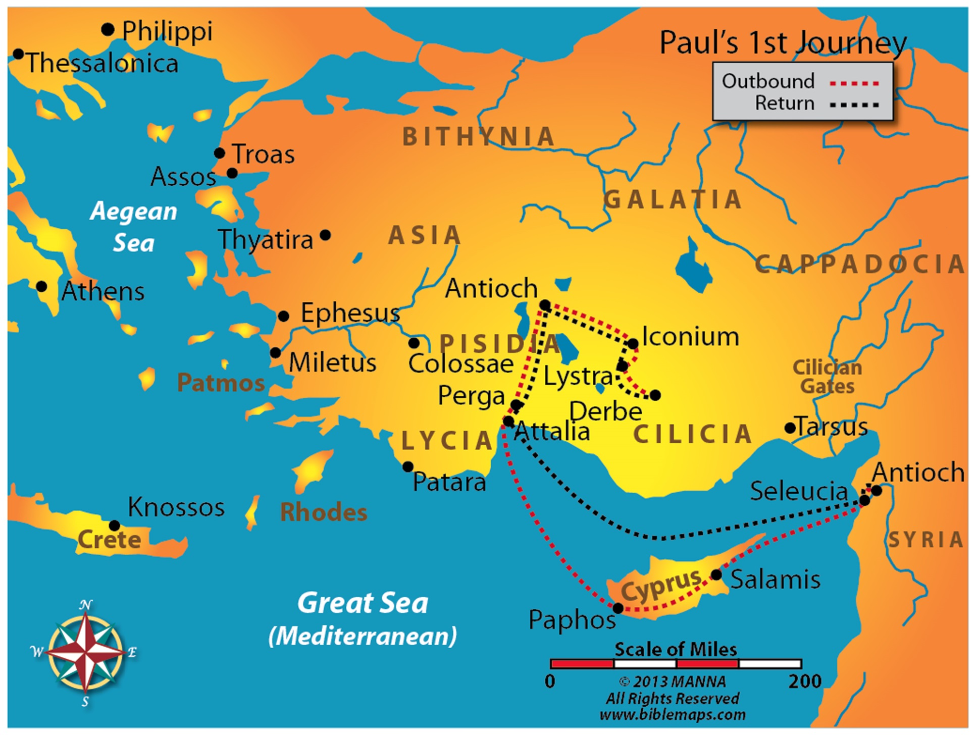
Maps Used By Permission By Manna Bible Maps

Slide 111
Lesson 13 - Acts 13
Beginning the First Missionary Journey
From Antioch to Cyprus (vv. 1-12)
At Antioch in Pisidia (vv. 13-52)

Slide 112
Lesson 13 - Acts 13
Herod Persecutes The Church
From Antioch to Cyprus (vv. 1-12)
Saul and Barnabas sent forth (vv. 1-3)
Preaching in Cyprus (vv. 4-12)

Slide 113
Lesson 13 - Acts 13
Beginning of the First Missionary Journey
From Antioch to Cyprus (vv. 1-12)
At Antioch in Pisidia (vv. 13-52)
From Paphos to Antioch (vv. 13-15)
Paul’s sermon in Antioch (vv. 16-41)
A brief history of Israel awaiting the Messiah (vv. 16-22)

Slide 114
Lesson 13 - Acts 13
Beginning of the First Missionary Journey
From Antioch to Cyprus (vv. 1-12)
At Antioch in Pisidia (vv. 13-52)
From Paphos to Antioch (vv. 13-15)
Paul’s sermon in Antioch (vv. 16-41)
Israel has a savior: Jesus (vv. 23-29)
John’s testimony about Jesus (vv. 23-25)
Jesus put to death –fulfilled prophecy (vv. 26-29)
Jesus raised from the dead (vv. 30-37)
Remission of sins proclaimed (by faith) through Jesus (vv. 38-39)

Slide 115
Lesson 13 - Acts 14
Opposition Faced & Completion of the First Journey
From Antioch to Cyprus (vv. 1-12)
At Antioch in Pisidia (vv. 13-52)
From Paphos to Antioch (vv. 13-15)
Paul’s sermon in Antioch (vv. 16-41)
Israel has a savior: Jesus (vv. 23-29)
A warning about unbelief (vv. 40-41)

Slide 116
Lesson 13 - Acts 14
Opposition Faced & Completion of the First Journey
From Antioch to Cyprus (vv. 1-12)
At Antioch in Pisidia (vv. 13-52)
From Paphos to Antioch (vv. 13-15)
Paul’s sermon in Antioch (vv. 16-41)
Results of the sermon (vv. 42-52)
Interest of the Gentiles aroused (vv. 42-43)
Jews become envious (vv. 44-52)
Refused the word and persecute (vv. 44-49)
Paul and Barnabas depart to Iconium (vv. 50-52)

Slide 117
Lesson 13 - Acts 14
Opposition Faced and Completion of First Journey
At Iconiumn (vv. 1-7)
At Lystra (vv. 8-20)
At Derbe and the Return Trip Home (vv. 20b-28)

Slide 118
Lesson 13 - Acts 14
Opposition Faced and Completion of First Journey
At Iconiumn (vv. 1-7)
Great multitudes (Jews and Gentiles) believed (v. 1)
Some unbelieving Jews created a stir (vv. 2-7)
Poisoned the minds of the Gentiles against the brethren (v. 2)
Great debate (vv. 3-4)

Slide 119
Lesson 13 - Acts 14
Opposition Faced and Completion of First Journey
At Iconiumn (vv. 1-7)
Great multitudes (Jews and Gentiles) believed (v. 1)
Some unbelieving Jews created a stir (vv. 2-7)
Attempted to abuse and stone the apostles (v. 5)
Paul and Barnabas fled to Lystra and Derbe (vv. 6-7)

Slide 120
Lesson 13 - Acts 14
Opposition Faced and Completion of First Journey
At Iconiumn (vv. 1-7)
At Lystra (vv. 8-20)
Crippled man healed (vv. 8-10)
People attempted to worship Paul and Barnabas (vv. 11-18)
Offered praise and prepared to sacrifice (vv. 11-13)
Paul and Barnabas responded (vv. 14-18)
We are men like you (vv. 14-15a)
Preach: that you should turn from these things to the living God (vv. 15b-17)

Slide 121
Lesson 13 - Acts 14
Opposition Faced and Completion of First Journey
At Iconiumn (vv. 1-7)
At Lystra (vv. 8-20)
Crippled man healed (vv. 8-10)
People attempted to worship Paul and Barnabas (vv. 11-18)
Scarcely restrained them (vv. 18)
Jews (from Antioch and Iconium) persecuted the disciples and stoned Paul (vv. 19-20a)

Slide 122
Lesson 13 - Acts 14
Opposition Faced and Completion of First Journey
At Iconiumn (vv. 1-7)
At Lystra (vv. 8-20)
At Derbe and the Return Trip Home (vv. 20b-28)
Many believed at Derbe (vv. 20b-21a)

Slide 123
Lesson 13 - Acts 14
Opposition Faced and Completion of First Journey
At Iconiumn (vv. 1-7)
At Lystra (vv. 8-20)
At Derbe and the Return Trip Home (vv. 20b-28)
Many believed at Derbe (vv. 20b-21a)
Return home via revisiting churches (vv. 21b-28)
At Lystra, Iconium and Antioch (vv. 21-23)
Strengthened and exhorted (vv. 21-22)
Appointed elders in every church (v. 23)

Slide 124
Lesson 13 - Acts 14
Opposition Faced and Completion of First Journey
At Iconiumn (vv. 1-7)
At Lystra (vv. 8-20)
At Derbe and the Return Trip Home (vv. 20b-28)
Many believed at Derbe (vv. 20b-21a)
Return home via revisiting churches (vv. 21b-28)
At Perga – preached (vv. 24-25a)

Slide 125
Lesson 13 - Acts 14
Opposition Faced and Completion of First Journey
At Iconiumn (vv. 1-7)
At Lystra (vv. 8-20)
At Derbe and the Return Trip Home (vv. 20b-28)
Many believed at Derbe (vv. 20b-21a)
Return home via revisiting churches (vv. 21b-28)
Back at Antioch (vv. 25b-28)
Reported their work (v. 27)
Stayed a long time (v. 28)

Slide 126
Lesson 14
Acts 15

Slide 127
Lesson 14 - Acts 15
The Jerusalem Discussion about Circumcision
The Discussion in Jerusalem (vv. 1-29)
The Church at Antioch Received the Letter (vv. 30-35)
Beginning the Second Journey (vv. 36-41)

Slide 128
Lesson 14 - Acts 15
The Jerusalem Discussion about Circumcision
The Discussion in Jerusalem (vv. 1-29)
The problem explained (vv. 1-5)
The speeches (vv. 6-21)
Peter spoke (vv. 7-11)
Paul and Barnabas spoke (v. 12)
James spoke (vv. 13-21)
A letter was sent from the apostles and elders to the Gentiles in Antioch (vv. 22-29)

Slide 129
Lesson 14 - Acts 15
The Jerusalem Discussion about Circumcision
The Discussion in Jerusalem (vv. 1-29)
The problem explained (vv. 1-5)
The speeches (vv. 6-21)
Peter spoke (vv. 7-11)
Paul and Barnabas spoke (v. 12)
James spoke (vv. 13-21)
A letter was sent from the apostles and elders to the Gentiles in Antioch (vv. 22-29)

Slide 130
Lesson 14 - Acts 15
The Jerusalem Discussion about Circumcision
The Discussion in Jerusalem (vv. 1-29)
The Church at Antioch Received the Letter (vv. 30-35)
Rejoiced over its encouragement (vv. 30-32)
The brethren depart (vv. 33-35)
Some returned to the apostles (v. 33)
Silas, Paul and Barnabas stay in Antioch (vv. 34-35)

Slide 131
Lesson 14 - Acts 15
The Jerusalem Discussion about Circumcision
The Discussion in Jerusalem (vv. 1-29)
The Church at Antioch Received the Letter (vv. 30-35)
Beginning the Second Journey (vv. 36-41)
Paul and Barnabas disagree over John Mark (vv. 36-38)
Paul and Barnabas separate (vv. 39-41)
Barnabas and John Mark sail to Cyprus (v. 39)
Paul and Silas go through Syria and Cilicia (vv. 40-41)

Slide 132
Lesson 15
Acts 16

Slide 133
Lesson 15 - Acts 16
Starting the Second Journey
Churches of the First Journey Revisited (vv. 1-5)
From Antioch (of Pisidia) to Philippi (vv. 6-12)
At Philippi (vv. 13-40)

Slide 134
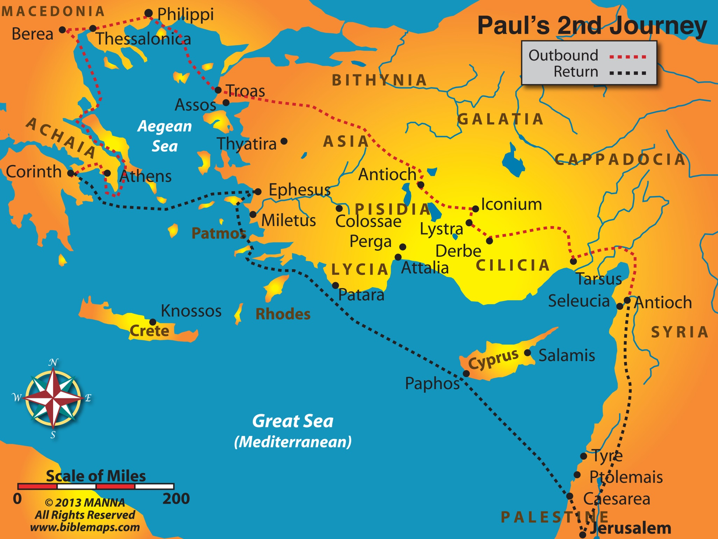
Maps Used By Permission By Manna Bible Maps

Slide 135
Lesson 15 - Acts 16
Starting the Second Journey
Churches of the First Journey Revisited (vv. 1-5)
Timothy joins Paul and Silas (vv. 1-3)
The churches were doing well (vv. 4-5)

Slide 136
Lesson 15 - Acts 16
Starting the Second Journey
Churches of the First Journey Revisited (vv. 1-5)
From Antioch (of Pisidia) to Philippi (vv. 6-12)
From Antioch to Troas (vv. 6-8)
From Troas to Philippi (vv. 9-12)
The call to Macedonia (vv. 9-10)
The move to Philippi (vv. 11-12)

Slide 137
Lesson 15 - Acts 16
Starting the Second Journey
Churches of the First Journey Revisited (vv. 1-5)
From Antioch (of Pisidia) to Philippi (vv. 6-12)
At Philippi (vv. 13-40)
Conversion of Lydia (vv. 13-15)
Damsel with spirit of divination (vv. 16-18)
Paul and Silas imprisoned (vv. 19-24)
Conversion of the jailor (vv. 25-34)
Release from jail and departure (vv. 35-40)

Slide 138
Lesson 16
Acts 17

Slide 139
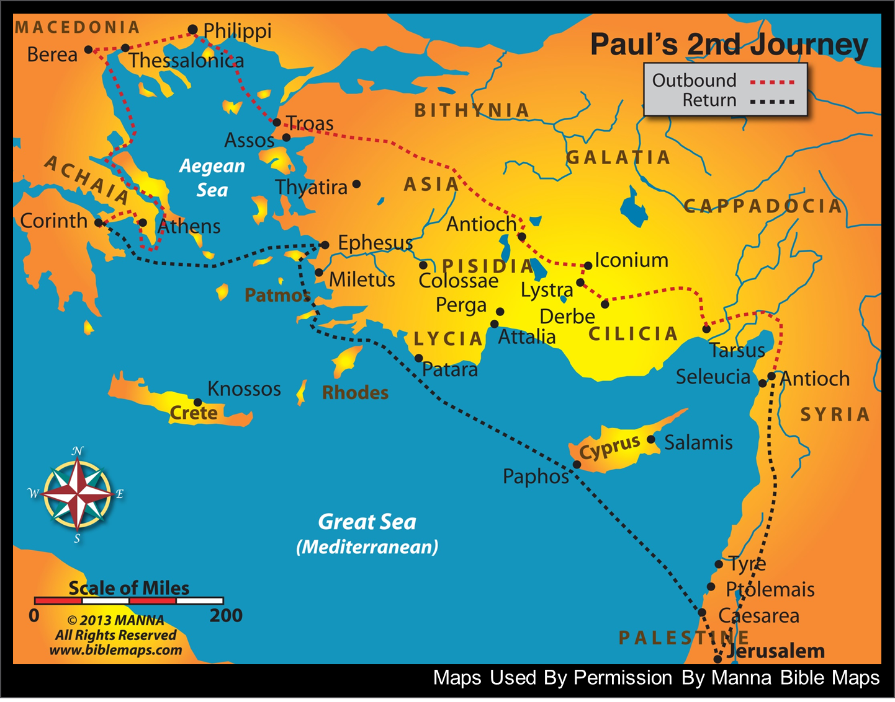

Slide 140
Lesson 16 - Acts 17
From Thessalonica to Athens
At Thessalonica (vv. 1-9)
At Berea (vv. 10-15)
At Athens (vv. 16-34)

Slide 141
Lesson 16 - Acts 17
From Thessalonica to Athens
At Thessalonica (vv. 1-9)
Preached Christ in the synagogue – many are converted (vv. 1-4)
Unbelieving Jews persecute and assault the house of Jason (vv. 5-9)

Slide 142
Lesson 16 - Acts 17
From Thessalonica to Athens
At Thessalonica (vv. 1-9)
At Berea (vv. 10-15)
Preached Christ in the synagogue – many are converted (vv. 10-12)
Jews of Thessalonica come to Berea and stirred the people (v. 13)
Paul sent away to Athens (Timothy and Silas go later) (vv. 14-15)

Slide 143
Lesson 16 - Acts 17
From Thessalonica to Athens
At Thessalonica (vv. 1-9)
At Berea (vv. 10-15)
At Athens (vv. 16-34)
The situation in Athens (vv. 16-21)
City wholly given to idolatry (v. 16)
Paul preached and disputed with them (vv. 17-18)
Paul taken and questioned (vv. 19-21)

Slide 144
Lesson 16 - Acts 17
From Thessalonica to Athens
At Thessalonica (vv. 1-9)
At Berea (vv. 10-15)
At Athens (vv. 16-34)
The situation in Athens (vv. 16-21)
Paul’s sermon on Mar’s Hill (vv. 22-31)
The Athenians – ignorant of God (vv. 22-23)
The Living God (vv. 24-29)
Made the world (vv. 24-25)
Made man (vv. 26-29)

Slide 145
Lesson 16 - Acts 17
From Thessalonica to Athens
At Thessalonica (vv. 1-9)
At Berea (vv. 10-15)
At Athens (vv. 16-34)
The situation in Athens (vv. 16-21)
Paul’s sermon on Mar’s Hill (vv. 22-31)
God demands repentance (vv. 30-31)
Because he will judge the world (v. 31)
In view of the assurance of the resurrection of Christ (v. 31)

Slide 146
Lesson 16 - Acts 17
From Thessalonica to Athens
At Thessalonica (vv. 1-9)
At Berea (vv. 10-15)
At Athens (vv. 16-34)
The situation in Athens (vv. 16-21)
Paul’s sermon on Mar’s Hill (vv. 22-31)
Response to Paul’s sermon (vv. 32-34)
Some mocked (vv. 32-33)
Some believed (v. 34)

Slide 147
Lesson 17
Acts 18

Slide 149
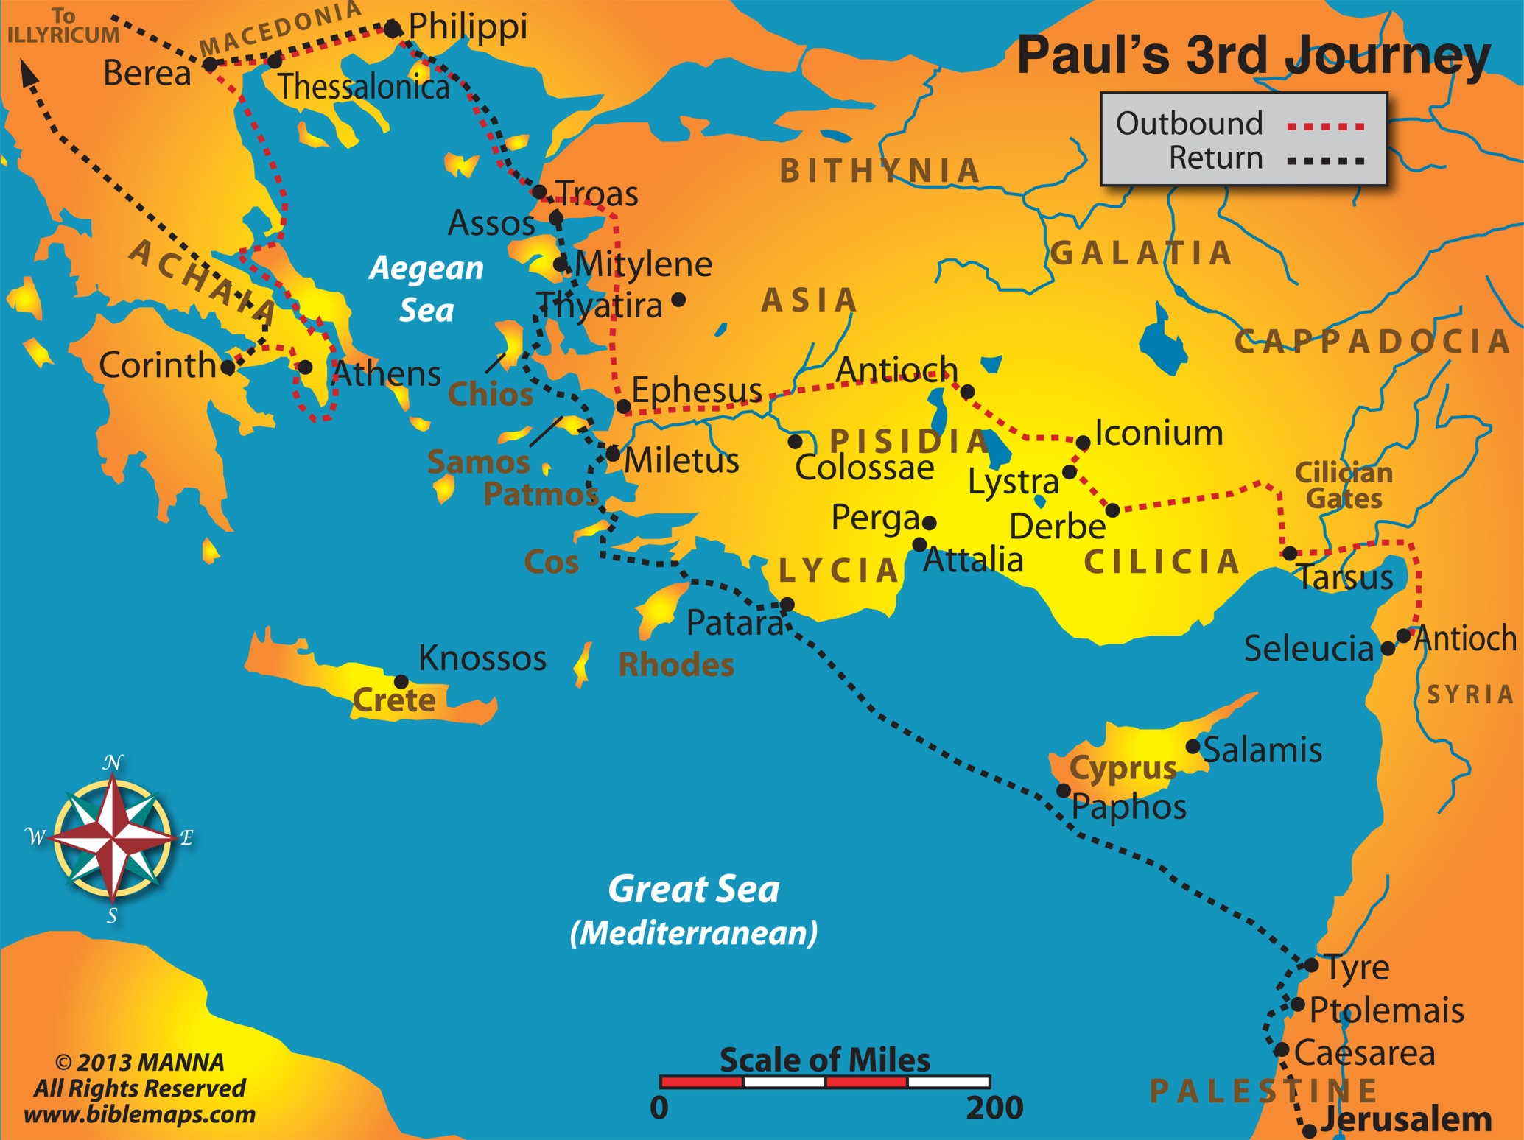
Maps Used By Permission By Manna Bible Maps

Slide 150
Lesson 17 - Acts 18
Finishing the Second Journey and Starting the Third
At Corinth (vv. 1-17)
Return Trip to Antioch (vv. 18-22)
Beginning the Third Journey (vv. 23-28)

Slide 151
Lesson 17 - Acts 18
Finishing the Second Journey and Starting the Third
At Corinth (vv. 1-17)
Paul begins his work in the city (vv. 1-4)
His work continues with help and opposition (vv. 5-11)
Silas and Timothy come from Macedonia (v. 5)
Opposition from the Jews (v. 6)
Paul continued there a year and a half with success (vv. 7-11)
Paul before Gallio (vv. 12-17)

Slide 152
Lesson 17 - Acts 18
Finishing the Second Journey and Starting the Third
At Corinth (vv. 1-17)
Return Trip to Antioch (vv. 18-22)
From Corinth to Ephesus (vv. 18-21)
Pricilla and Aquila travel with Paul as far as Ephesus (vv. 18-19a)
Paul reasoned with the Jews in the synagogue (v. 19b)
Paul left for Jerusalem (vv. 20-21)
From Ephesus to Jerusalem and on to Antioch (v. 22)

Slide 153
Lesson 17 - Acts 18
Finishing the Second Journey and Starting the Third
At Corinth (vv. 1-17)
Return Trip to Antioch (vv. 18-22)
Beginning the Third Journey (vv. 23-28)
Paul strengthened the disciples of Galatia and Phrygia (v. 23)
Apollos at Ephesus (vv. 24-28)
Apollos came to Ephesus (vv. 24-25a)
Great speaker (v. 24)
Well versed in Scripture (vv. 24-25a)
Taught well – but lacking in one area (v. 25b)

Slide 154
Lesson 17 - Acts 18
Finishing the Second Journey and Starting the Third
At Corinth (vv. 1-17)
Return Trip to Antioch (vv. 18-22)
Beginning the Third Journey (vv. 23-28)
Paul strengthened the disciples of Galatia and Phrygia (v. 23)
Apollos at Ephesus (vv. 24-28)
Aquila and Priscilla corrected him (v. 26)
Went to Achaia (vv. 27-28)
With recommendation of the Ephesians (v. 27)
Helped those who believe (v. 27)
Publicly refuted the Jews (v. 28)

Slide 155
Lesson 18
Acts 19

Slide 156
Maps Used By Permission By Manna Bible Maps

Slide 157
Lesson 18 - Acts 19
At Ephesus
Twelve Disciples are Baptized and Receive the Holy Spirit (vv. 1-7)
Paul Preached and Disputed with the Jews (vv. 8-10)
Miracles and Exorcist (vv. 11-20)
Paul Plans for a Future Journey (vv. 21-22)
Uproar over Idolatry (vv. 23-41)

Slide 158
Lesson 18 - Acts 19
At Ephesus
Twelve Disciples are Baptized and Receive the Holy Spirit (vv. 1-7)
Had not received the Holy Spirit since they were only baptized with John’s baptism (vv. 1-4)
Baptized in the name of the Lord (v. 5)
Received the Holy Spirit (v. 6)
The number was twelve (v. 7)

Slide 159
Lesson 18 - Acts 19
At Ephesus
Twelve Disciples are Baptized and Receive the Holy Spirit (vv. 1-7)
Paul Preached and Disputed with the Jews (vv. 8-10)
In the synagogue for about three months (vv. 8-9a)
In the school of Tyrannus for two years (vv. 9b-10)

Slide 160
Lesson 18 - Acts 19
At Ephesus
Twelve Disciples are Baptized and Receive the Holy Spirit (vv. 1-7)
Paul Preached and Disputed with the Jews (vv. 8-10)
Miracles and Exorcist (vv. 11-20)
God wrought unusual miracles by Paul (vv. 11-12)
Exorcist exposed (vv. 13-17)
Many obeyed (vv. 18-20)

Slide 161
Lesson 18 - Acts 19
At Ephesus
Twelve Disciples are Baptized and Receive the Holy Spirit (vv. 1-7)
Paul Preached and Disputed with the Jews (vv. 8-10)
Miracles and Exorcist (vv. 11-20)
Paul Plans for a Future Journey (vv. 21-22)
Plans to go to Macedonia, Achaia, Jerusalem and Rome (v. 21)
Sends Timothy and Erastus to Macedonia (v. 22)

Slide 162
Lesson 18 - Acts 19
At Ephesus
Twelve Disciples are Baptized and Receive the Holy Spirit (vv. 1-7)
Paul Preached and Disputed with the Jews (vv. 8-10)
Miracles and Exorcist (vv. 11-20)
Paul Plans for a Future Journey (vv. 21-22)
Uproar over Idolatry (vv. 23-41)
Demetrius stirred up the people (vv. 23-28)
A demonstration in the theater (vv. 29-34)
The city clerk appeased the people and dismissed the assembly (vv. 35-41)

Slide 163
Lesson 18 - Acts 19
At Ephesus
Uproar over Idolatry (vv. 23-41)
The city clerk appeased the people and dismissed the assembly (vv. 35-41)
Since Ephesus is the guardian of the temple of Diana, ought to be quiet and do nothing rashly (vv. 35-36)
If there are other charges, the courts are open (vv. 37-39)
Dismissed the disorderly meeting (vv. 40-41)

Slide 164
Lesson 19
Acts 20

Slide 165
Maps Used By Permission By Manna Bible Maps

Slide 166
Lesson 19 - Acts 20
In Macedonia and Greece, Worship at Troas, and a Visit with the Ephesian Elders
Paul’s Second Visit to Macedonia and Greece (vv. 1-6)
Lord’s Day Meeting at Troas (vv. 7-12)
From Troas to Miletus (vv. 13-16)
Paul Talked with the Ephesians Elders at Miletus (vv. 17-38)

Slide 167
Lesson 19 - Acts 20
In Macedonia and Greece, Worship at Troas, and a Visit with the Ephesian Elders
Paul’s Second Visit to Macedonia and Greece (vv. 1-6)
Encouraged the brethren in Macedonia (vv. 1-2a)
Spent three months in Greece (vv. 2a-3a)
Traveled back through Macedonia and sailed to Troas (vv. 3b-6)

Slide 168
Lesson 19 - Acts 20
In Macedonia and Greece, Worship at Troas, and a Visit with the Ephesian Elders
Paul’s Second Visit to Macedonia and Greece (vv. 1-6)
Lord’s Day Meeting at Troas (vv. 7-12)
Observed the Lord’s Supper (v. 7a)
Paul preached (v. 7b)
Eutychus fell out of the window (vv. 8-12)

Slide 169
Lesson 19 - Acts 20
In Macedonia and Greece, Worship at Troas, and a Visit with the Ephesian Elders
Paul’s Second Visit to Macedonia and Greece (vv. 1-6)
Lord’s Day Meeting at Troas (vv. 7-12)
From Troas to Miletus (vv. 13-16)

Slide 170
Lesson 19 - Acts 20
In Macedonia and Greece, Worship at Troas, and a Visit with the Ephesian Elders
Paul’s Second Visit to Macedonia and Greece (vv. 1-6)
Lord’s Day Meeting at Troas (vv. 7-12)
From Troas to Miletus (vv. 13-16)
Paul Talked with the Ephesians Elders at Miletus (vv. 17-38)

Slide 171
Lesson 19 - Acts 20
In Macedonia and Greece, Worship at Troas, and a Visit with the Ephesian Elders
Paul Talked with the Ephesians Elders at Miletus (vv. 17-38)
Reviewed his past work (vv. 17-21, 26-27, 33-35)
Served the Lord with humility, tears and trials (vv. 17-19)
Kept nothing back, but taught you the whole counsel of God (vv. 20-21; 26-27)
Provided for myself by working and taught you to support the weak (vv. 33-35)

Slide 172
Lesson 19 - Acts 20
In Macedonia and Greece, Worship at Troas, and a Visit with the Ephesian Elders
Paul Talked with the Ephesians Elders at Miletus (vv. 17-38)
Anticipation of trip to Jerusalem (vv. 22-25)
Chains and tribulation await me (vv. 22-23)
Yet, I plan to preach the gospel (v. 24)
You will see me no more (v. 25)
A Charge and warning to the elders (vv. 28-32)
Take heed to and shepherd the flock (v. 28)
Apostasy will come from among you (vv. 29-31)
Commend you to the word of God’s grace (v. 32)
Paul departs (vv. 36-38)

Slide 173
Lesson 20
Acts 21

Slide 174
Maps Used By Permission By Manna Bible Maps

Slide 175
Lesson 20 - Acts 21
Ending the Third Journey and Paul Arrested in Jerusalem
From Miletus To Jerusalem (vv. 1-17)
Paul Arrested in Jerusalem (vv. 18-40)

Slide 176
Lesson 20 - Acts 21
Ending the Third Journey and Paul Arrested in Jerusalem
From Miletus To Jerusalem (vv. 1-17)
Sailing from Miletus to Tyre (vv. 1-3)
Stayed seven days in Tyre with the disciples (vv. 4-6)
Came to Caesarea and stayed with Philip (vv. 7-9)
The prophet Agabus foretold of Paul’s arrest and imprisonment (vv. 10-11)
Paul was determined to go to Jerusalem anyway (vv. 12-14)
Paul went to Jerusalem (vv. 15-17)

Slide 177
Lesson 20 - Acts 21
Ending the Third Journey and Paul Arrested in Jerusalem
From Miletus To Jerusalem (vv. 1-17)
Paul Arrested in Jerusalem (vv. 18-40)
Paul went before James and the elders (vv. 18-25)
Paul reported his work among the Gentles (vv. 18-19)
James and the elders warned about the results of false rumors about him (vv. 20-22)
James and the elders suggested that Paul take four men and observe Jewish customs to prove the rumor false (vv. 23-24)
James and the elders restated that the law should not be bound on the Gentiles (v. 25)

Slide 178
Lesson 20 - Acts 21
Ending the Third Journey and Paul Arrested in Jerusalem
From Miletus To Jerusalem (vv. 1-17)
Paul Arrested in Jerusalem (vv. 18-40)
Paul went before James and the elders (vv. 18-25)
Paul went into the temple (v. 26).
The uproar (vv. 27-32)
Paul accused of teaching against the law and taking Gentiles into the temple (vv. 27-29).
Paul dragged out of the temple and beaten by a mob (vv. 30-32).
Paul’s arrest (vv. 33-36).
Paul given permission to speak (vv. 37-40)

Slide 179
Lesson 21
Acts 22

Slide 180
Lesson 21 - Acts 22
Paul’s Defense
Paul’s Speech before the People (vv. 1-21)
The Immediate Effects of Paul’s Speech (vv. 22-30)

Slide 181
Lesson 21 - Acts 22
Paul’s Defense
Paul’s Speech before the People (vv. 1-21)
Life before my conversion (vv. 1-5)
Brought up in the strictness of the Jewish religion (vv. 1-3)
Persecuted Christians (vv. 4-5)

Slide 182
Lesson 21 - Acts 22
Paul’s Defense
Paul’s Speech before the People (vv. 1-21)
My conversion (vv. 6-16)
The Lord appeared to me on the road to Damascus (vv. 6-11)
Ananias came and preached to me (vv. 12-16)
He restored my sight (vv. 12-13)
He told me that God chose me to be a witness to the Gentiles (vv. 14-15)
He commanded that I be baptized (v. 16)

Slide 183
Lesson 21 - Acts 22
Paul’s Defense
Paul’s Speech before the People (vv. 1-21)
I was called to preach to the Gentiles (vv. 17-21)
The Lord told me to get out of Jerusalem quickly (vv. 17-18)
I said that they know how I persecuted Christians (vv. 19-20)
The Lord said, “Depart, for I will sent you to the Gentiles” (v. 21)

Slide 184
Lesson 21 - Acts 22
Paul’s Defense
Paul’s Speech before the People (vv. 1-21)
The Immediate Effects of Paul’s Speech (vv. 22-30)
Mob cried, “Away with him...” (vv. 22-23)
Tore their clothes
Threw dust in the air

Slide 185
Lesson 21 - Acts 22
Paul’s Defense
Paul’s Speech before the People (vv. 1-21)
The Immediate Effects of Paul’s Speech (vv. 22-30)
Soldiers attempted to scourge him (vv. 24-29)
Commander ordered scourging to know why the mob cried (v. 24)
Paul asked if it were lawful to scourge a Roman being uncondemned (v. 25)
When they learned that he was a Roman, they withheld scourging (vv. 26-29)
Paul brought before the Sanhedrin (v. 30)

Slide 186
Lesson 22
Acts 23

Slide 187
Lesson 22 - Acts 23
Paul Before the Sanhedrin and Delivered to Caesarea
Paul before the Sanhedrin (vv. 1-10)
The Lord Appeared to Paul At Night (v. 11)
A Plot Against Paul Revealed (vv. 12-22)
Paul Delivered to Caesarea (vv. 23-25)

Slide 188
Lesson 22 - Acts 23
Paul Before the Sanhedrin and Delivered to Caesarea
Paul before the Sanhedrin (vv. 1-10)
Paul said that he had lived in good conscience (v. 1)
Ananias commanded that Paul be struck on the mouth (vv. 2-5)
Paul rebuked Ananias (v. 3)
The people rebuked Paul for reviling the High Priest (vv. 4-5)

Slide 189
Lesson 22 - Acts 23
Paul Before the Sanhedrin and Delivered to Caesarea
Paul before the Sanhedrin (vv. 1-10)
Paul stated that he was condemned because of the hope of the resurrection from the dead (vv. 6-10)
He did this knowing that the group was made up of Pharisees and Sadducees (v. 6)
Caused dissension between the Pharisees and Sadducees (vv. 7-10a)
Because of their difference on the resurrection (v. 8)
Pharisees cried out that they found no fault in Paul (v. 9)
Commander had Paul taken to the Barracks lest he be killed (v. 10b)

Slide 190
Lesson 22 - Acts 23
Paul Before the Sanhedrin and Delivered to Caesarea
Paul before the Sanhedrin (vv. 1-10)
The Lord Appeared to Paul At Night (v. 11)
Lord told Paul to be of good cheer (v. 11)
Lord told Paul that he would testify of him in Rome (v. 11)

Slide 191
Lesson 21 - Acts 22
Paul Before the Sanhedrin and Delivered to Caesarea
Paul before the Sanhedrin (vv. 1-10)
The Lord Appeared to Paul At Night (v. 11)
A Plot Against Paul Revealed (vv. 12-22)
Forty (plus) Jews took an oath to kill Paul (vv. 12-15)
Oath was not to eat or drink anything until they killed Paul (vv. 12-13)
Plotted with the chief priest and elders to have Paul brought to the council so they could kill him on the way (vv. 14-15)
Paul’s nephew spoiled the plot (vv. 16-22)
Informed Paul (v. 16)
Paul sent him to the Commander (vv. 17-22)

Slide 192
Lesson 21 - Acts 22
Paul Before the Sanhedrin and Delivered to Caesarea
Paul before the Sanhedrin (vv. 1-10)
The Lord Appeared to Paul At Night (v. 11)
A Plot Against Paul Revealed (vv. 12-22)
Paul Delivered to Caesarea (vv. 23-25)
The commander prepared protection to bring Paul to Felix (vv. 23-24)
A letter from Lysias to Felix was sent along with Paul (vv. 25-30)
Paul delivered to Felix (vv. 31-35)

Slide 193
Lesson 23
Acts 24

Slide 194
Lesson 23 - Acts 24
Paul Before Felix
The Charge (vv. 1-9)
The Defense (vv. 10-21)
The Delay (vv. 22-23)
The Sermon (vv. 24-25a)
The Wait (vv. 25b-27)

Slide 195
Lesson 23 - Acts 24
Paul Before Felix
The Charge (vv. 1-9)
The Accusers (vv. 1-4)
High priest and elders (v. 1)
Hired an orator – Tertullus (vv. 1-2)
Used flatter (vv. 2-4)

Slide 196
Lesson 23 - Acts 24
Paul Before Felix
The Charge (vv. 1-9)
The Accusers (vv. 1-4)
The Accusations (vv. 5-7)
Four charges (vv. 5-6)
He is a plague (v. 5)
He is a creator of dissension (v. 5)
He is a ringleader of the sect of the Nazarenes (v. 5)
He tried to profane the temple (v. 6)
We would have given him a fair trial, but Lysias took him by violence (vv. 6-7)

Slide 197
Lesson 23 - Acts 24
Paul Before Felix
The Charge (vv. 1-9)
The Accusers (vv. 1-4)
The Accusations (vv. 5-7)
The Evidence (vv. 8-9)
Your examination (v. 8)
Jews agreed with Tertullus (v. 9)

Slide 198
Lesson 23 - Acts 24
Paul Before Felix
The Charge (vv. 1-9)
The Defense (vv. 10-21)
Glad to answer for myself (v. 10)
They cannot prove the accusations (vv. 11-13)
The reason is that I didn’t do these things – thus no evidence (vv. 11-12)
They can’t prove it (v. 13)

Slide 199
Lesson 23 - Acts 24
Paul Before Felix
The Charge (vv. 1-9)
The Defense (vv. 10-21)
Glad to answer for myself (v. 10)
They cannot prove the accusations (vv. 11-13)
Confess that I am of the Way they call a sect (vv. 14-15)
Worship according to that way (v. 14a)
Believe all that is in the law and prophets (v. 14b)
Have hope that there will be a resurrection (v. 15)
Have always tried to have a clear conscience (v. 16)

Slide 200
Lesson 23 - Acts 24
Paul Before Felix
The Charge (vv. 1-9)
The Defense (vv. 10-21)
Where are the witnesses (vv. 17-20)?
Reason I came to Jerusalem (v. 17)
They didn’t find me doing wrong (v. 18)
If I have done wrong, they should be here (v. 19)
Let those from the council say what I did wrong there (v. 20)
The reason I am being judged – is the resurrection (v. 21)

Slide 201
Lesson 23 - Acts 24
Paul Before Felix
The Charge (vv. 1-9)
The Defense (vv. 10-21)
The Delay (vv. 22-23)
Because of his knowledge of the Way (v. 22a)
Deferred until Lysias would come (vv. 22b)
Kept Paul in prison – but gave him liberty (v. 23)

Slide 202
Lesson 23 - Acts 24
Paul Before Felix
The Charge (vv. 1-9)
The Defense (vv. 10-21)
The Delay (vv. 22-23)
The Sermon (vv. 24-25a)
It was requested (v. 24a)
It concerned the faith in Christ (v. 24b)
The content (v. 25a)
Righteousness – God’s plan for being righteous
Self-Control – submission to God’s will
Judgment to come – Reason one needs to be right

Slide 203
Lesson 23 - Acts 24
Paul Before Felix
The Charge (vv. 1-9)
The Defense (vv. 10-21)
The Delay (vv. 22-23)
The Sermon (vv. 24-25a)
The Wait (vv. 25b-27)
Was afraid (v. 25b)
Waited for convenient time (v. 25b)
While he waited (vv. 26-27)
Hoped for a bribe (v. 26)
Talked often with Paul (v. 26)
Left Paul bound for two years (v. 27)

Slide 204
Lesson 24
Acts 25 & 26

Slide 205
Lesson 23 - Acts 25
Paul Before Festus
Paul before Festus (vv. 1-12)
Festus Informs King Agrippa (vv. 13-22)
Festus Presents Paul to King Agrippa (vv. 23-27)

Slide 206
Lesson 23 - Acts 25
Paul Before Festus
Paul before Festus (vv. 1-12)
The Jews inform Festus about Paul (vv. 1-5)
They asked that Paul be brought to Jerusalem so they could kill him along the way (vv. 1-3)
Festus said he would go to Caesarea and asked the accusers to go with him (vv. 4-5)

Slide 207
Lesson 23 - Acts 25
Paul Before Festus
Paul before Festus (vv. 1-12)
Paul appeals to Caesar (vv. 6-12)
The Jews brought many charges against Paul, but no proof (vv. 6-7)
Paul responded saying he had done no wrong (v. 8)
Festus asked if Paul want to go to Jerusalem to be judged (v. 9)
Paul asked to go before Caesar (vv. 10-12)

Slide 208
Lesson 23 - Acts 25
Paul Before Festus
Paul before Festus (vv. 1-12)
Festus Informs King Agrippa (vv. 13-22)
Festus tells of Paul’s appeal to Caesar (vv. 13-21)
Paul is a prisoner left by Felix (v. 14)
When informed I waited until his accusers came (vv. 15-16)
The accusations were not what I thought – it was about Jesus whom Paul affirms to be alive (vv. 17-19)
Paul appealed to Caesar (vv. 20-21)
King Agrippa says he will hear Paul himself (v. 22)

Slide 209
Lesson 23 - Acts 25
Paul Before Festus
Paul before Festus (vv. 1-12)
Festus Informs King Agrippa (vv. 13-22)
Festus Presents Paul to King Agrippa (vv. 23-27)
All entered the auditorium (v. 23)

Slide 210
Lesson 23 - Acts 25
Paul Before Festus
Paul before Festus (vv. 1-12)
Festus Informs King Agrippa (vv. 13-22)
Festus Presents Paul to King Agrippa (vv. 23-27)
Festus asked king Agrippa to hear Paul so he would have something to write to Caesar (vv. 24-27)
The Jews say he is not fit to live (v. 24)
But I (Festus) found no cause of death (v. 25a)
He appealed to Caesar, so I am sending him (v. 25b)
I have nothing to write to Caesar, so I brought him to you (vv. 26-27)

Slide 211
Lesson 23 - Acts 26
Paul Before Agrippa
Paul’s Defense before Agrippa (vv. 1-23)
Reaction to Paul’s Defense (vv. 24-32)

Slide 212
Lesson 23 - Acts 26
Paul Before Agrippa
Paul’s Defense before Agrippa (vv. 1-23)
I am happy to speak – beg you to hear (vv. 1-3)
My life before my conversion (vv. 4-11)
Was raised as a Jew (v. 4)
Was a Pharisee – the strictest sect (v. 5)
Held to the promise made to our fathers (vv. 6-8)
This (still holding to the promise) is why I am accused (vv. 6-7)
Why should it be thought incredible that God should raise the dead (v. 8)?
I was opposed to Jesus of Nazareth and persecuted his people (vv. 9-11)

Slide 213
Lesson 23 - Acts 26
Paul Before Agrippa
Paul’s Defense before Agrippa (vv. 1-23)
I am happy to speak – beg you to hear (vv. 1-3)
My life before my conversion (vv. 4-11)
My conversion (vv. 12-18)
A bright light shone on me while on the road to Damascus (vv. 12-13)
I heard a voice from heaven (vv. 14-18)
The voice asked why I was persecuting him (v. 14)
The voice identified himself as Jesus (v. 15)
Jesus called me to preach to the Gentiles (vv. 16-18)

Slide 214
Lesson 23 - Acts 26
Paul Before Agrippa
Paul’s Defense before Agrippa (vv. 1-23)
I am happy to speak – beg you to hear (vv. 1-3)
My life before my conversion (vv. 4-11)
My conversion (vv. 12-18)
I have been fulfilling my mission to preach to the Gentiles (vv. 19-23)
I preached to the Jews first and then to the Gentiles (vv. 19-20)
This is the reason they seek to kill me (v. 21)
By God’s help I continue to preach what the prophets said about Christ (vv. 22-23)

Slide 215
Lesson 23 - Acts 26
Paul Before Agrippa
Paul’s Defense before Agrippa (vv. 1-23)
Reaction to Paul’s Defense (vv. 24-32)
Festus said he was mad (vv. 24-26)
Agrippa was almost persuaded (vv. 27-29)
Two conclusions (vv. 30-32)
Done nothing worthy of death or chains (v. 31)
Would be set free – except he appealed to Caesar (v. 32)

Slide 216
Lesson 25
Acts 27

Slide 217
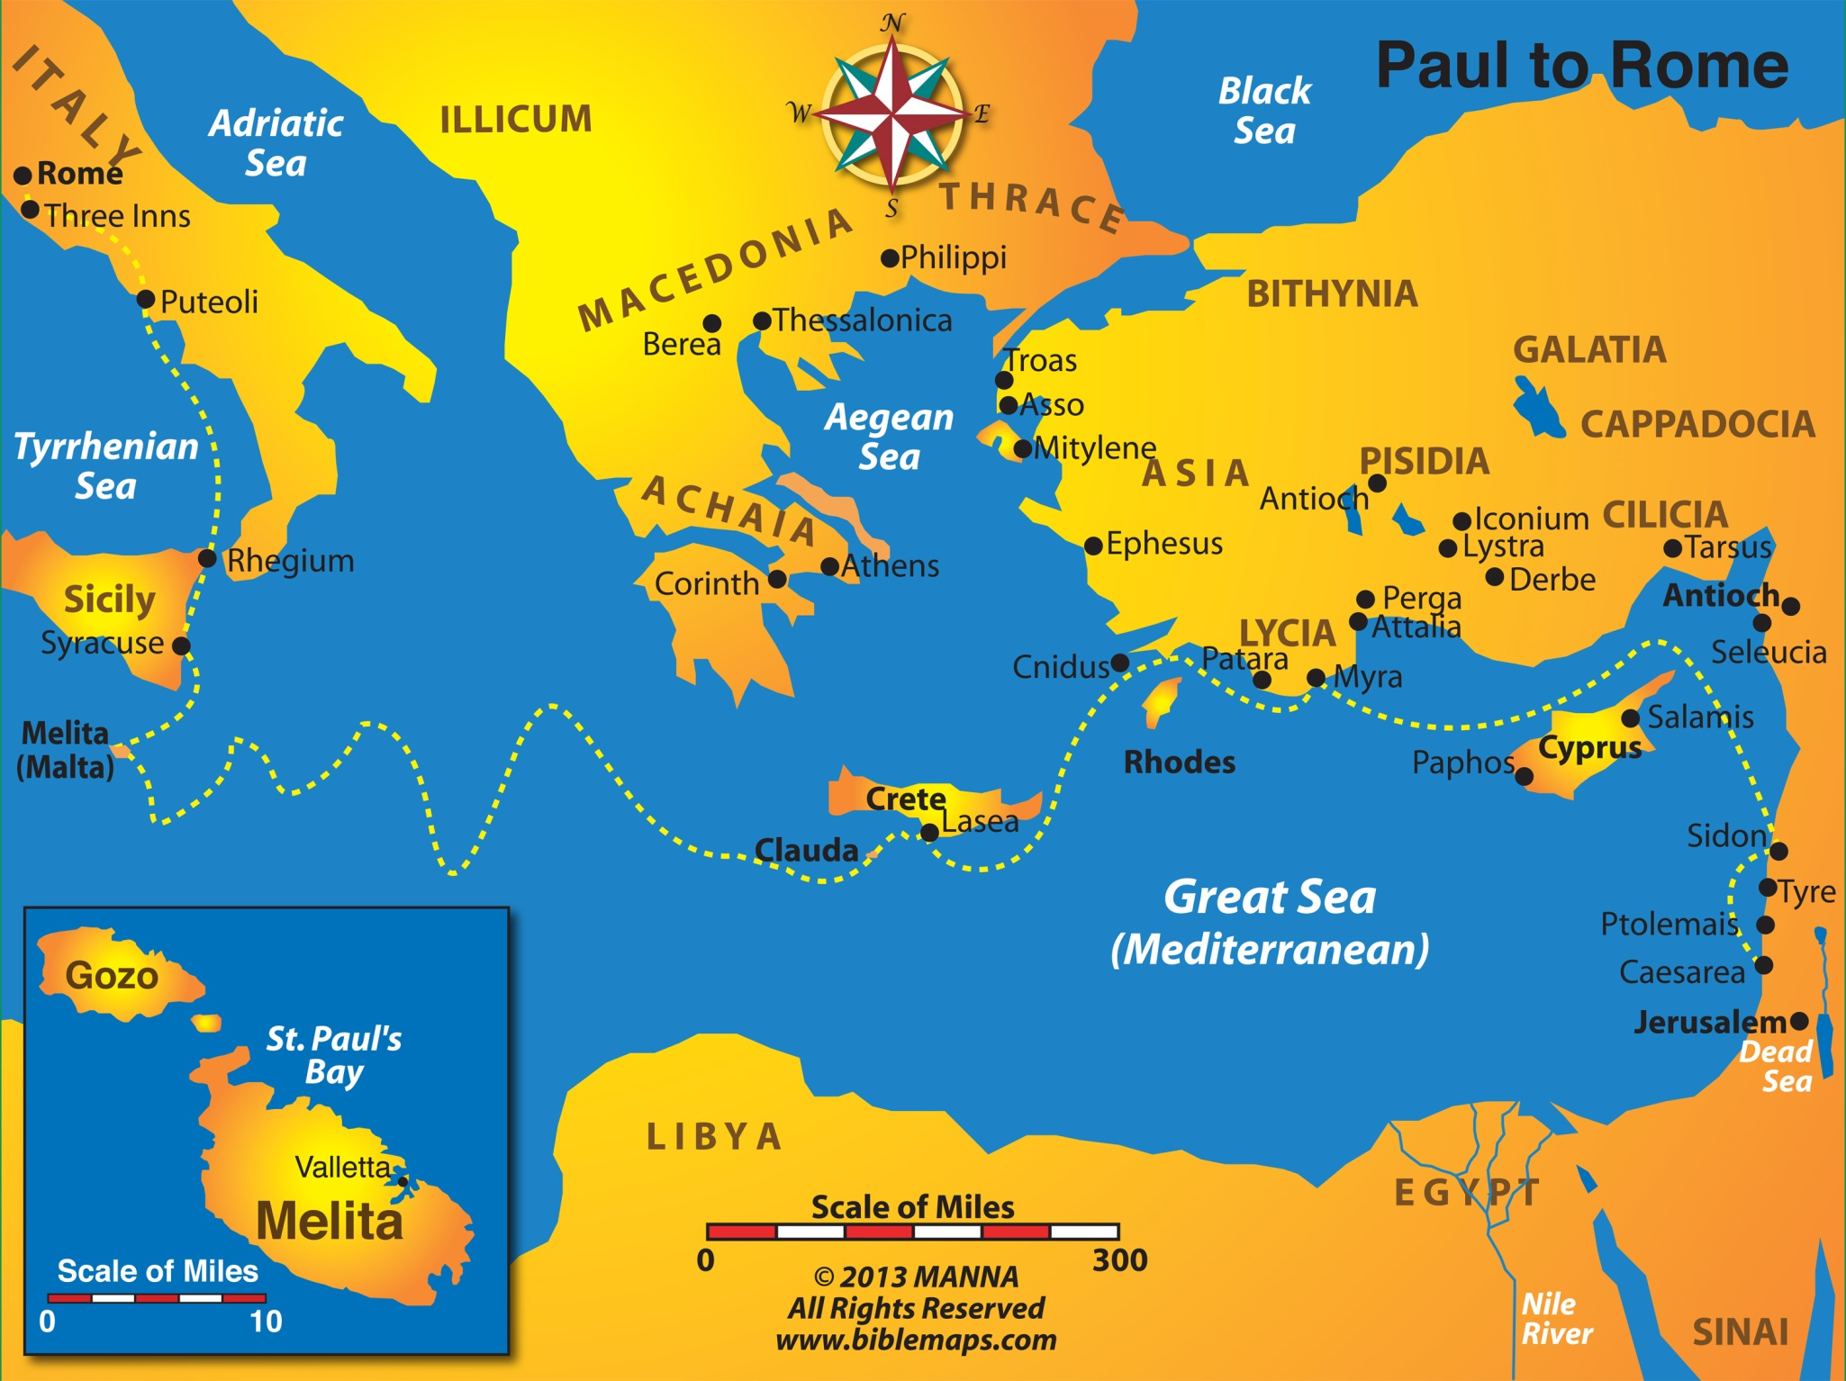
Maps Used By Permission By Manna Bible Maps

Slide 218
Lesson 25 - Acts 27
Voyage to Rome – Shipwreck at Sea
From Caesarea to Fair Havens (vv. 1-12)
From Fair Havens to Malta (vv. 13-44)

Slide 219
Lesson 25 - Acts 27
Voyage to Rome – Shipwreck at Sea
From Caesarea to Fair Havens (vv. 1-12)
The way of travel (vv. 1-8)
From Caesarea to Sidon (vv. 1-3)
Sailed over Cyprus to Myra (vv. 4-6)
Sailed to Cnidus, under Crete to Fair Havens (vv.7-8)

Slide 220
Lesson 25 - Acts 27
Voyage to Rome – Shipwreck at Sea
From Caesarea to Fair Havens (vv. 1-12)
The way of travel (vv. 1-8)
Paul warned against continuing the voyage (vv. 9-12)
Paul warned of losing the ship, cargo and lives (vv. 9-10)
They kept sailing (vv. 11-12)
The helmsman and the owner wanted to keep sailing (v. 11)
The harbor was not suitable to winter in (v. 12)

Slide 221
Lesson 25 - Acts 27
Voyage to Rome – Shipwreck at Sea
From Caesarea to Fair Havens (vv. 1-12)
From Fair Havens to Malta (vv. 13-44)
A storm at Sea (vv. 13-38)
A strong wind and darkness scared all on board (vv. 13-20)
Paul warned that all must stay aboard ship (vv. 21-26)
As they sailed close to land, they put anchors down and waited for day (vv. 27-38)

Slide 222
Lesson 25 - Acts 27
Voyage to Rome – Shipwreck at Sea
From Caesarea to Fair Havens (vv. 1-12)
From Fair Havens to Malta (vv. 13-44)
A storm at Sea (vv. 13-38)
Shipwreck - yet all are saved (vv. 39-44)
The ship ran aground and got stuck (vv. 39-41a)
The ship broke into pieces (v. 41b)
All escaped to land (vv. 42-44)

Slide 223
Lesson 26
Acts 28

Slide 224
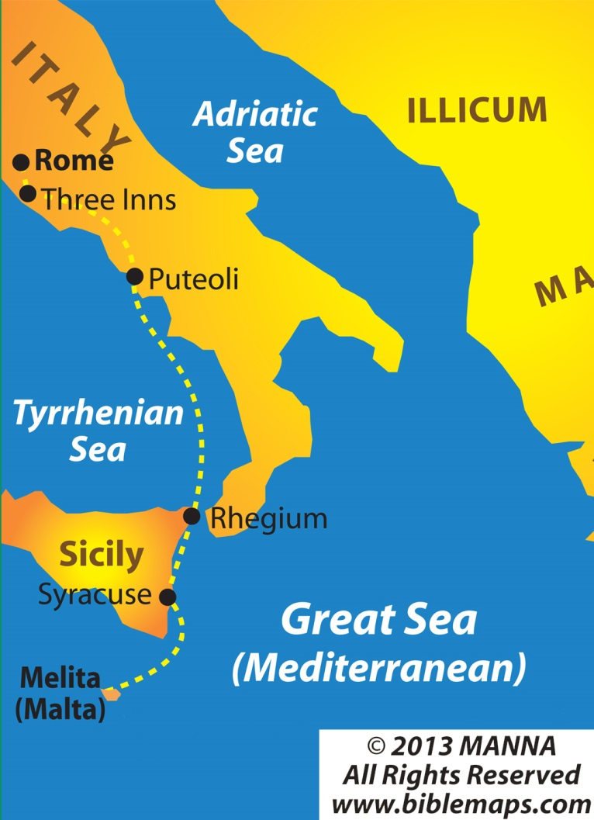

Slide 225
Lesson 26 - Acts 28
Arrival and Work in Rome
On the Island of Malta (vv. 1-10)
Arrival in Rome (vv. 11-16)
Preaching in Rome (vv. 17-31)

Slide 226
Lesson 26 - Acts 28
Arrival and Work in Rome
On the Island of Malta (vv. 1-10)
Paul was treated well on the island (vv. 1-2, 7, 10)
A viper bit Paul (vv. 3-6)
The people first thought that he was a murderer (vv.3-4)
Paul was not harmed (v. 5)
The people then concluded that he was a god (v. 6)
Paul heals some (vv. 7-9)
Heals the father of Publius (vv. 7-8)
Heals others who had diseases (v. 9)

Slide 227
Lesson 26 - Acts 28
Arrival and Work in Rome
On the Island of Malta (vv. 1-10)
Arrival in Rome (vv. 11-16)
Sailed to Syracuse and stayed three days (vv. 11-12)
Sailed on to Puteoli and stayed seven days (vv. 13-14)
Brethren from Rome met them in Appii Forum and Three Inns (v. 15)
Came to Rome (v. 16)

Slide 228
Lesson 26 - Acts 28
Arrival and Work in Rome
On the Island of Malta (vv. 1-10)
Arrival in Rome (vv. 11-16)
Preaching in Rome (vv. 17-31)
Paul talks to the leaders of the Jews (vv. 17-22)
Informs them why he is a prisoner and going before Caesar (vv. 17-20)
The Jews state what they have heard (vv. 21-22)
Nothing evil against Paul (v. 21)
But they knew that the “sect” was evil spoken of (v. 22)
Desired to hear more (v. 22)

Slide 229
Lesson 26 - Acts 28
Arrival and Work in Rome
On the Island of Malta (vv. 1-10)
Arrival in Rome (vv. 11-16)
Preaching in Rome (vv. 17-31)
Paul talks to the leaders of the Jews (vv. 17-22)
Preaching to the Jews about Christ (vv. 23-29).
Paul preached about Jesus from the Law and Prophets (v. 23)
Reaction (vv. 24-28)
Some believed (v. 24a)
Some disbelieved (v. 24b)

Slide 230
Lesson 26 - Acts 28
Arrival and Work in Rome
On the Island of Malta (vv. 1-10)
Arrival in Rome (vv. 11-16)
Preaching in Rome (vv. 17-31)
Paul talks to the leaders of the Jews (vv. 17-22)
Preaching to the Jews about Christ (vv. 23-29).
Paul preached about Jesus from the Law and Prophets (v. 23)
Reaction (vv. 24-28)
They departed when Paul spoke of the hardening of the Jew’s hearts and turning to the Gentiles (vv. 25-29)
Disputed among themselves (vv. 25, 28)

Slide 231
Lesson 26 - Acts 28
Arrival and Work in Rome
On the Island of Malta (vv. 1-10)
Arrival in Rome (vv. 11-16)
Preaching in Rome (vv. 17-31)
Paul talks to the leaders of the Jews (vv. 17-22)
Preaching to the Jews about Christ (vv. 23-29).
Continued preaching for two years (vv. 30-31)
In his own rented house (v. 30)
Allowed visitors (v. 30)
Preached and taught (v. 31)

