Slide 2
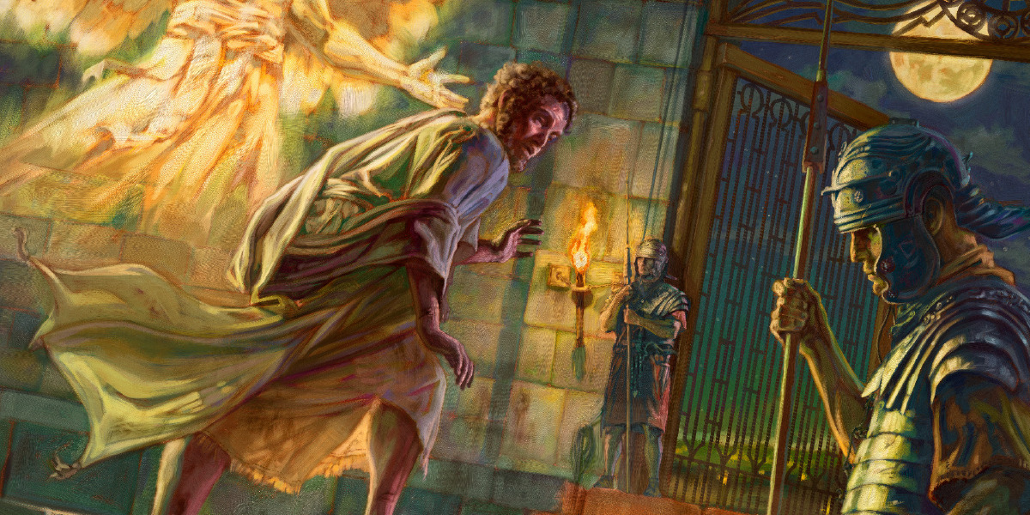

Slide 3
Of Evil Men (vv. 1, 18-23)
Matthew 2:16; 14:1-12
Of Persecution (vv. 1-4)
1 Peter 4:12-13; 2 Timothy 3:12
Of the Power of God (vv. 5-17)
Psalm 34:14-18; 2 Corinthians 12:9
Of Growth (vv. 24-25)
Isaiah 55:11; Nehemiah 1:17-18

