Slide 2
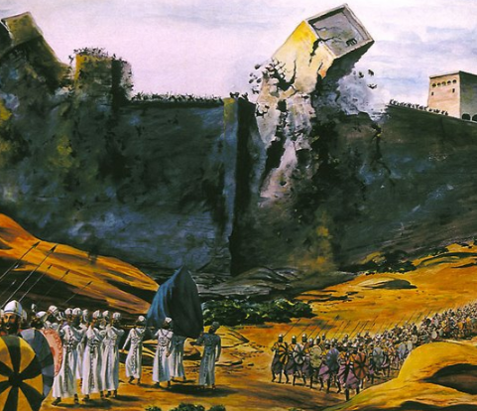

Slide 3
“The God of the Old Testament is arguably the most unpleasant character in all fiction; jealous and proud of it; a petty, unjust, unforgiving control freak; a vindictive, bloodthirsty ethnic cleanser; a misogynistic, homophobic, racist, infanticidal, genocidal, filicidal, pestilential, megalomaniacal, sadomasochistic, capriciously malevolent bully.”

Slide 4
If God is…why would He slaughter the Canaanites?
Love – 1 John 4:8
Good – Matthew 19:17
Full of Compassion and Tender Mercies – Psalm 145:8-9
Just – Psalm 89:14
The Name of God is Magnified in the Judgment of the Canaanites (Exodus 34:5-7)

Slide 5
The Canaanites Were Evil
They were disobedient to God – Hebrews 11:31; Rom. 1:18-20
They were so evil the land would vomit them out – Leviticus 18:24-25
Adultery (v. 20), Child Sacrifice (v. 21), Homosexuality (v. 22), Bestiality (v. 23)
God’s actions viewed in this context are understandable. (cf. Habakkuk 1:13)

Slide 6
His Longsuffering
He is slow to anger – Psalm 145:8
His track record – Genesis 6:3; 2 Peter 2:5 (Pre-flood); Genesis 18:16-33 (Sodom); Jonah (Nineveh)
His standard of national judgment – Jeremiah 18:7-10
No different for the Canaanites – Genesis 12:6-7; 15:12, 16

Slide 7
His Judgment
Their evil was complete, and God’s people needed to be spared from it – Deuteronomy 7:1-6; 20:16-18
What about innocent children? – Joshua 6:21; 1 Samuel 15:3; Ezekiel 18:20; Deuteronomy 1:39
Spared from bearing brunt of parents’ evil – cf. Num. 14:33
Spared from being influenced to stumble – cf. Matt. 18:6-7
His Prerogative – Job 1:21; Daniel 5:21; Deuteronomy 32:4

Slide 8
God’s Judgment Against the Canaanites Foreshadows the Eternal Judgment of All
(cf. Acts 24:24-25)
God’s Judgment Against the Canaanites Provided for the Escape of Eternal Condemnation for All
(cf. Acts 13:19-23)

