Slide 2
And Jesus came and spoke to them, saying, all authority has been given to Me in heaven and on earth (Matt 28:18).
…for He is Lord of lords and King of kings; and those who are with Him are called, chosen, and faithful (Rev 17:14).
God, who at various times and in various ways spoke in time past to the fathers by the prophets, has in these last days spoken to us by His Son, whom He has appointed heir of all things… (Heb 1:1-2).
For I have not spoken on My own authority; but the Father who sent Me gave Me a command, what I should say and what I should speak. And I know that His command is everlasting life. Therefore, whatever I speak, just as the Father has told Me, so I speak (Jn 12:49-50).

Slide 3
John 14:16-17
John 16:12-13
2 Peter 1:21
Acts 2:1-4
1 Corinthians 2:9-11
Ephesians 3:3-4
1 Corinthians 14:37

Slide 4
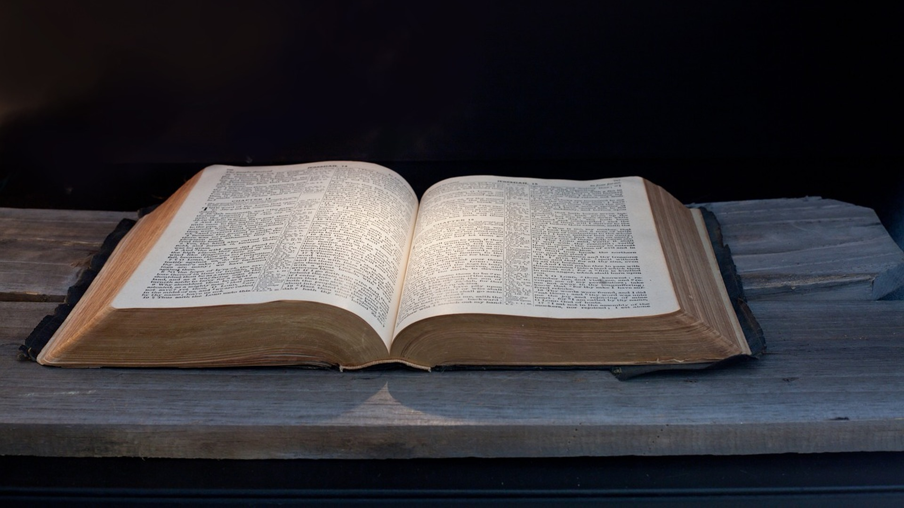
For this reason, we also thank God without ceasing, because when you received the word of God which you heard from us, you welcomed it not as the word of men, but as it is in truth, the word of God, which also effectively works in you who believe.
1 Thessalonians 2:13

Slide 5
Is Presumptuous ~ Psalm 19:13
Is Deadly ~ Genesis 3:1-5
Is Chaotic ~ Judges 17:6

Slide 6
We are of God. He who knows God hears us; he who is not of God does not hear us. By this we know the spirit of truth and the spirit of error.
1 John 4:6
(Mt 21:25) The baptism of John—where was it from? From heaven or from men?
This wisdom does not descend from above, but is earthly, sensual. demonic. For where envy and self-seeking exist, confusion and every evil thing are there. But the wisdom that is from above is first pure, then peaceable, gentle, willing to yield, full of mercy and good fruits, without partiality and without hypocrisy (James 3:15-17)
Truth Leads to Life, Jn 8:32
Error Leads to Death, Jas 5:20

Slide 7
“Anyone who thinks there is monolithic and always unified interpretation in ‘Christianity’ is simply uninformed.”
“If there is a way to correctly interpret Scripture, then why do so many ‘learned’ people come away with different interpretations?”
“If God had really inspired the Bible, wouldn’t He have written it clearly enough for everyone to understand?”

Slide 8
For we are not writing any other things to you than what you read or understand. Now I trust you will understand, even to the end (2 Cor 1:13).
By which, when you read, you may understand my knowledge in the mystery of Christ (Eph 3:4).
And that from childhood you have known the Holy Scriptures, which are able to make you wise for salvation through faith which is in Christ Jesus (2 Tim 3:15).

Slide 9
And whatever you do in word or deed, do all in the name of the Lord Jesus, giving thanks to God the Father through Him (Col 3:17).
Be diligent to present yourself approved to God, a worker who does not need to be ashamed, rightly dividing the word of truth (2 Tim 2:15).

