Slide 2
LOST
BAPTIZED (Ac 2:38)
CONFESS (Rom 10:10)
REPENT (Ac 2:38 / Ac 17:30 / Lk 24:47)
BELIEVE (Ac 16:31 / Ac 18:8 / Mk 16:16)
HEAR (Rom 10:14, 17 / Ac 2:37 / Ac 18:8)

Slide 3
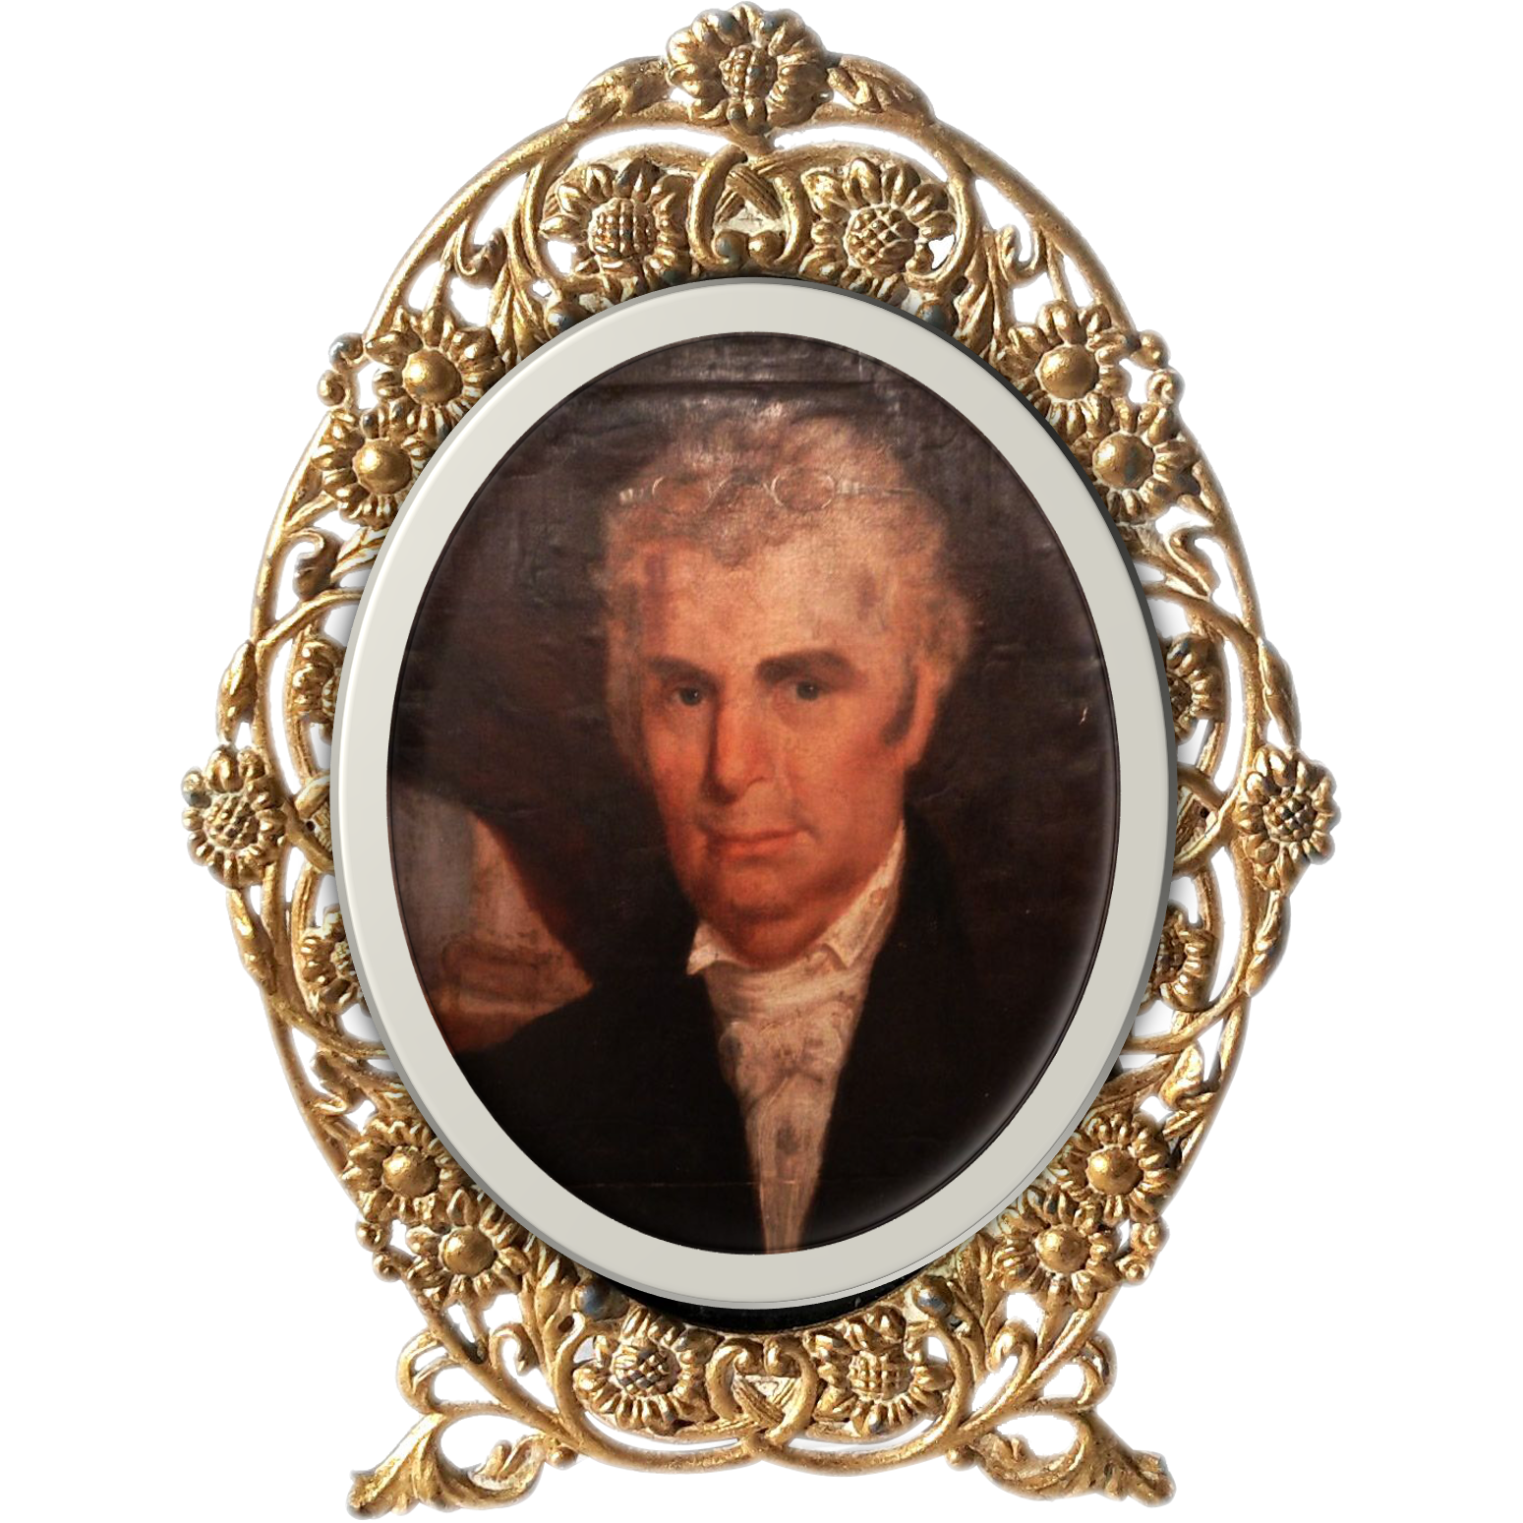
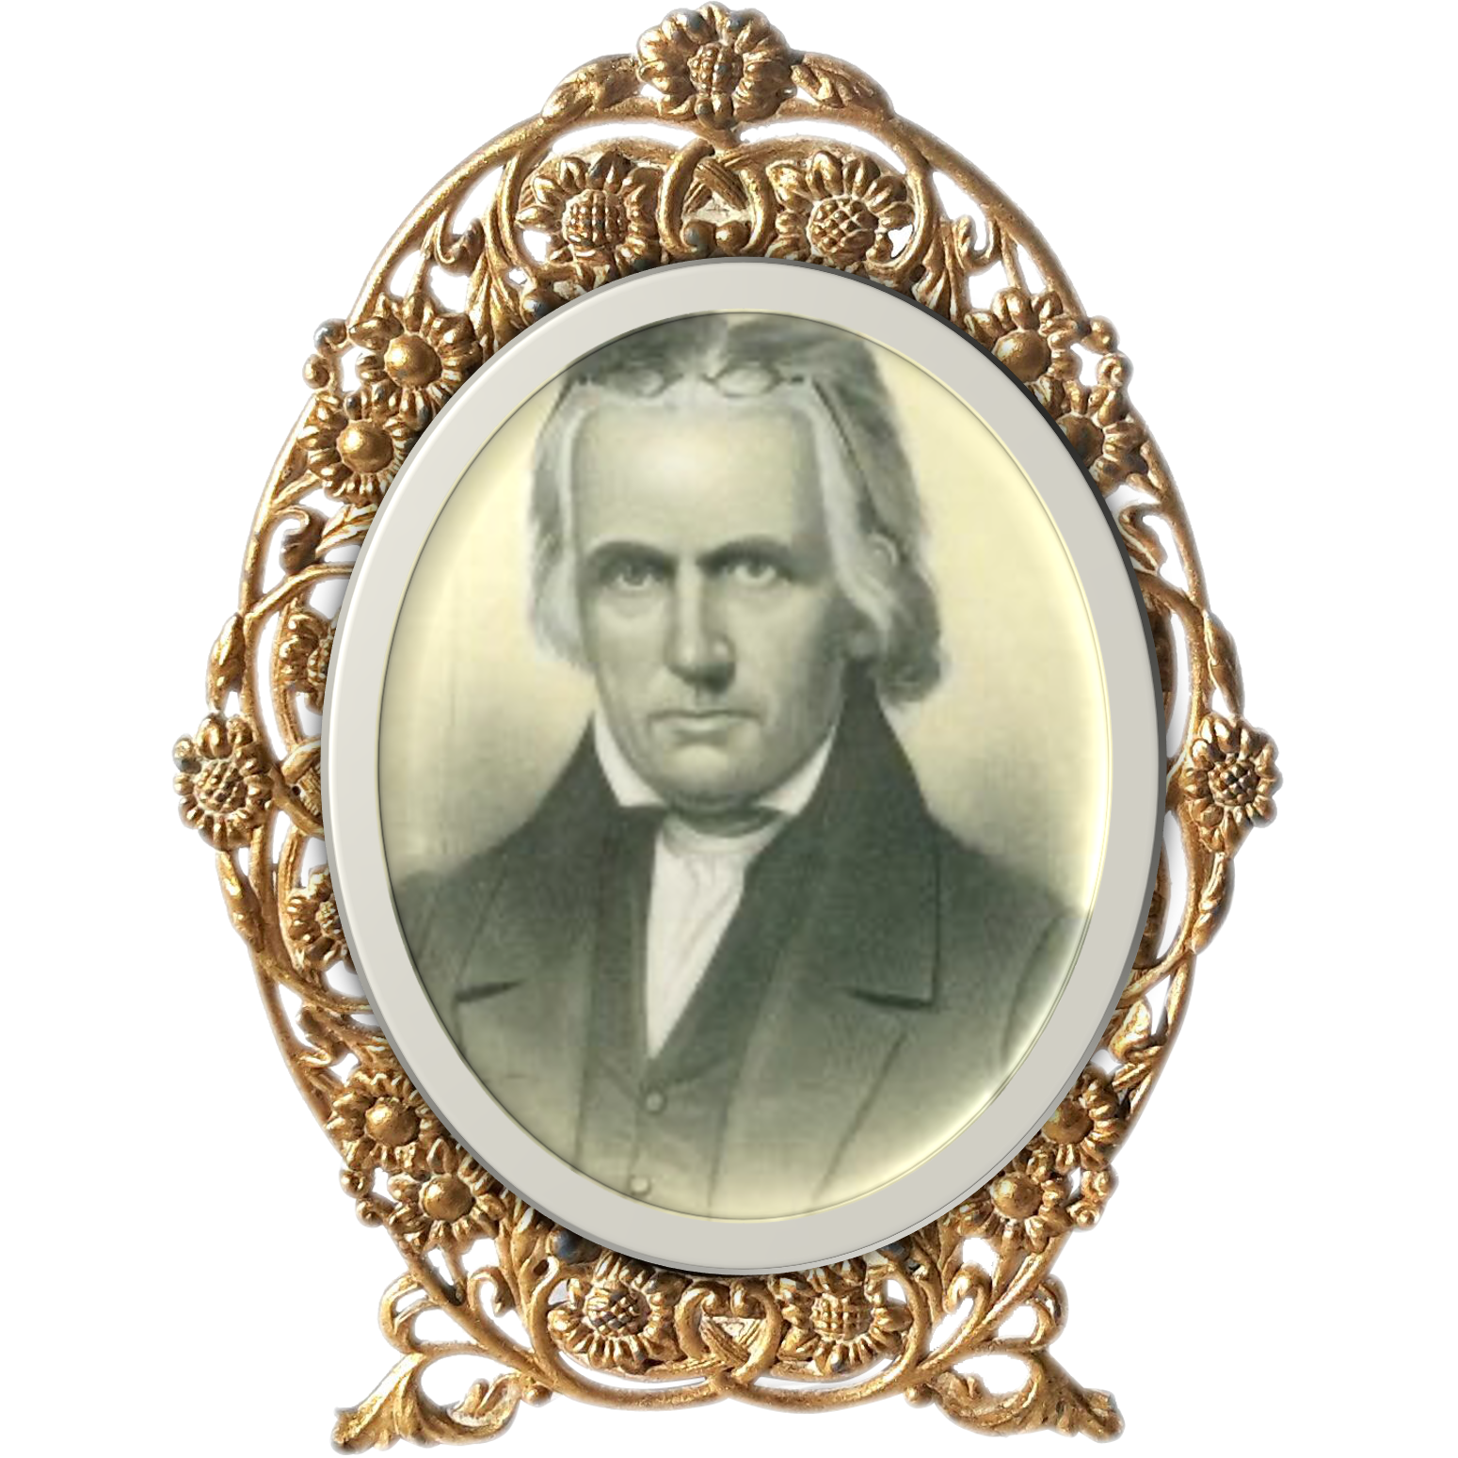
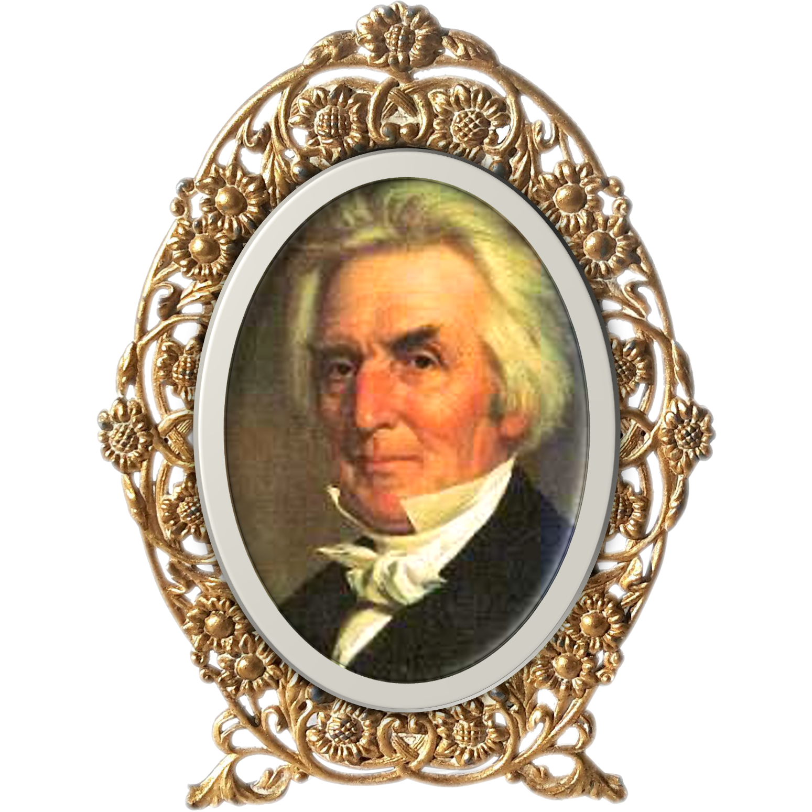
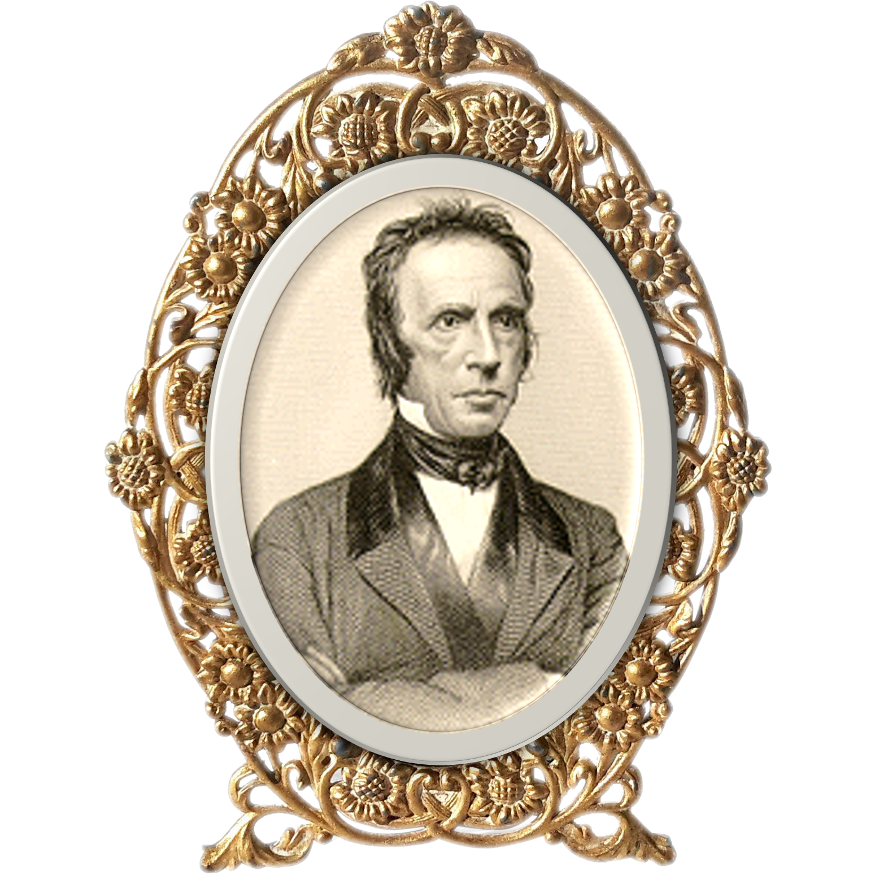
Pioneer Preachers of Restoration Movement
Barton W. Stone
Thomas Campbell
Alexander Campbell
Walter Scott

Slide 4
Walter Scott’s
5-Finger Exercise

Slide 5
LOST
BAPTIZED (Ac 2:38)
Once if BAPTIZED Scriptural
Daily CONFESS (Mt 10:32-33)
CONFESS (Rom 10:10)
Lifetime REPENTING (Lk 3:8; 2 Co 7:11)
REPENT (Ac 2:38 / Ac 17:30 / Lk 24:47)
BELIEVE (Ac 16:31 / Ac 18:8 / Mk 16:16)
A Lifetime of BELIEVING (Mt 6:33; Ac 27:25)
HEAR (Rom 10:14, 17 / Ac 2:37 / Ac 18:8)
Continue HEARING for life (2 Tim 2:15 / Matt 13:9)

Slide 6
Do not fear any of those things which you are about to suffer. Indeed, the devil is about to throw some of you into prison, that you may be tested, and you will have tribulation ten days. Be faithful until death, and I will give you the crown of life.
Revelation 2:10
Faithful to the
End

