Slide 1
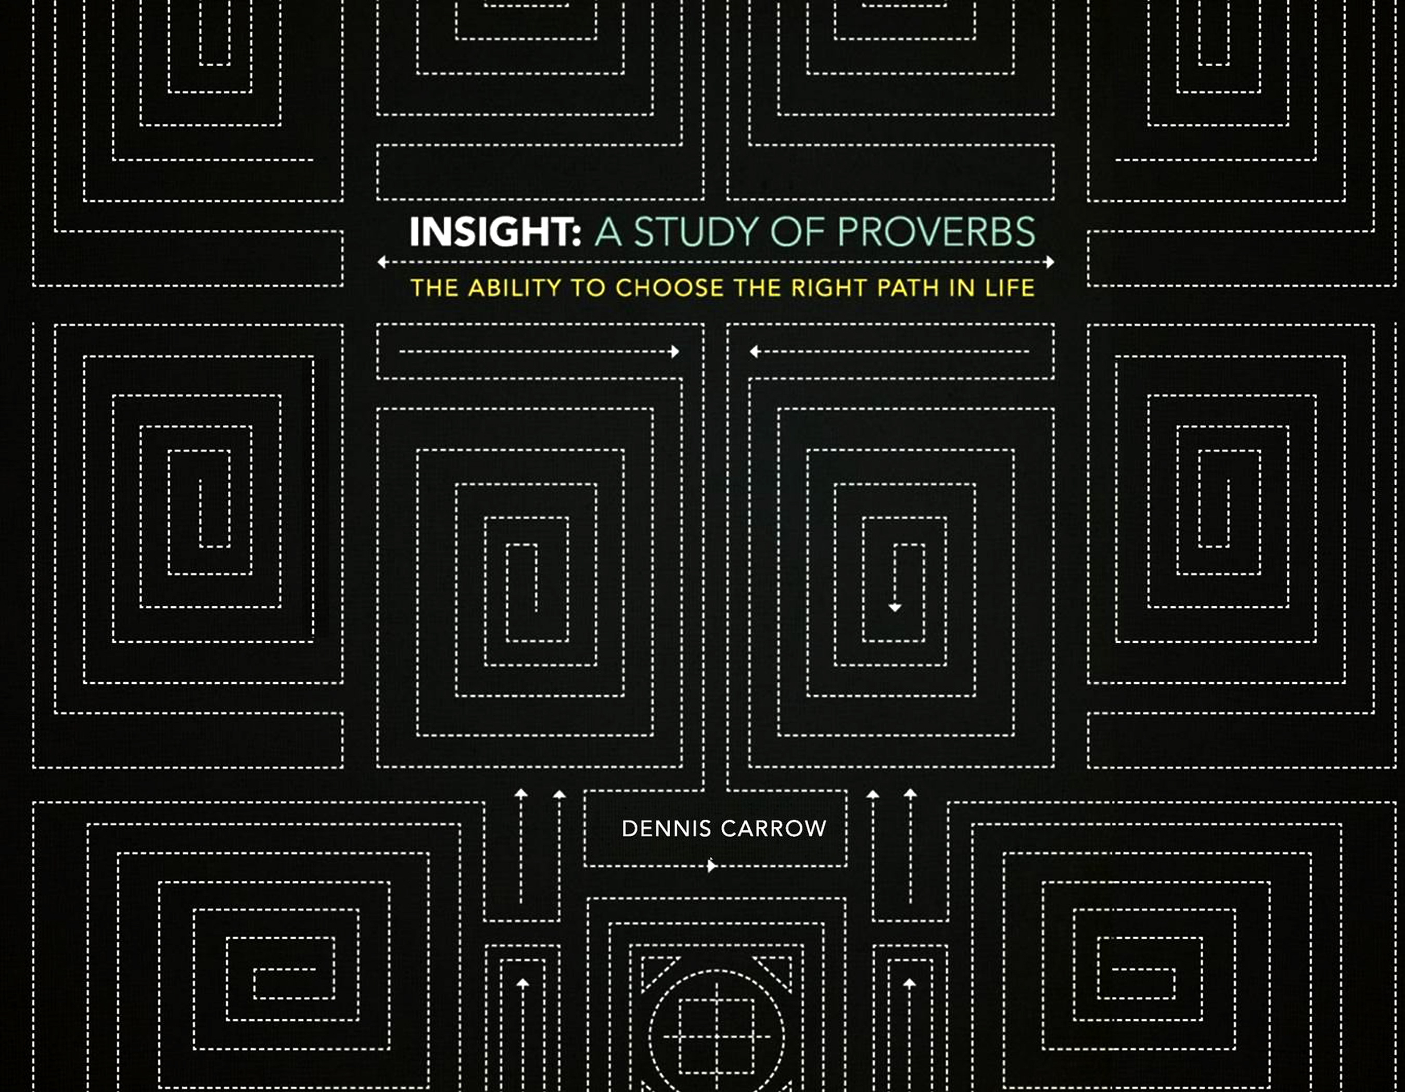

Slide 2

The Benefit of Wisdom: Character, Confidence, & Contentment

Slide 3

The Benefits Of Wisdom:
Character, Confidence, & Contentment
Consider the things you hope to get out of life.
Long Life (vv. 2, 16)
Favor and High Esteem (v. 4)
Health and Strength (v. 8)
Material Blessings (v. 10)
Happiness, Rest, and Peace (vv.17,18,24)
Deliverance From Trouble (vv. 25,26)
Eternal Life (vv. 35)

Slide 4
Trust in the Lord and He will Direct and Bless Your Life
(Read Proverbs 3:1-10)
The Benefits Of Wisdom:
Character, Confidence, & Contentment

Slide 5
Some Lessons Not Easily Learned, but the Result is Priceless Peace
(Read Proverbs 3:11-18)
The Benefits Of Wisdom:
Character, Confidence, & Contentment

Slide 6
The Creative Power of Wisdom
(Read Proverbs 3:19-26)
The Benefits Of Wisdom:
Character, Confidence, & Contentment

Slide 7
Share That Which God Gives With Others
(Read Proverbs 3:27-35)
The Benefits Of Wisdom:
Character, Confidence, & Contentment

Slide 8
Meditate and Memorize:
The Lord will be your confidence, and keep your foot from being caught (vs. 26)
The Benefits Of Wisdom:
Character, Confidence, & Contentment
Remember our purpose of gaining wisdom is to learn how to make the right decisions in our life, without having to experience those things that are wrong.

Slide 9
The Benefits Of Wisdom:
Character, Confidence, & Contentment
Discuss some benefits you have received by making application of wisdom in you life.
What is the result of rejecting God’s instruction?
What do we learn in v. 3 about the nature of wisdom?
Explain how we bind God’s commands around our neck and write them on the tablets of our heart.
How can a person lose wisdom?

