Slide 1
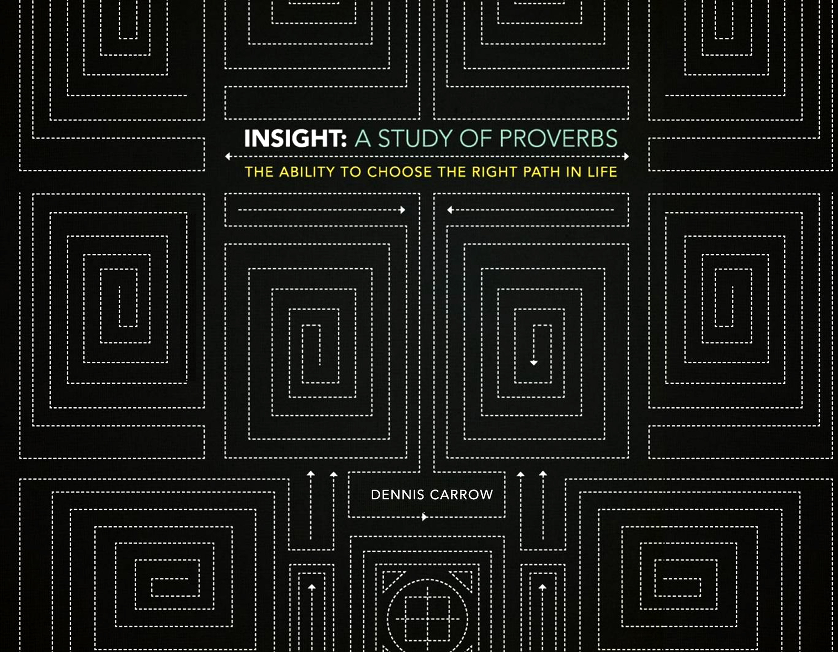

Slide 2
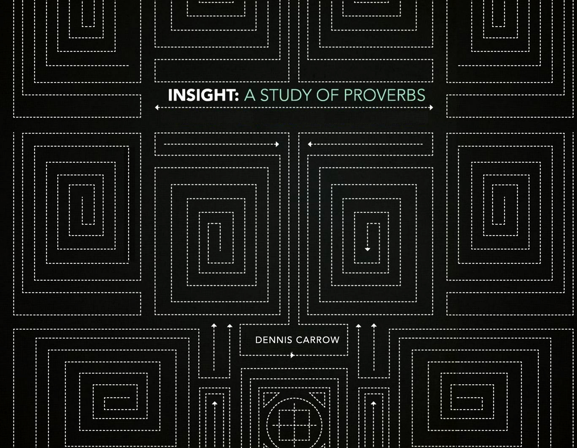
The Effects Of Wisdom:
Preservation & Contentment

Slide 3

Lesson 4 Summary?
The Effects Of Wisdom: Preservation & Contentment
Listen to sound advice
Pathway of wisdom
Pathway of wicked
Practical advice

Slide 4
The Effects Of Wisdom: Preservation & Contentment
Choice
Pathway of
Wisdom
Listen
Disregard
Pathway of
Wicked
Good Things
Bad Things
Preservation, Deliverance, Life, Health, Success, Glory, Honor
Preoccupied with Evil, Violence, Hinderance, Stumbling, Darkness

Slide 5
Over-view of Chapter 4
The Effects Of Wisdom: Preservation & Contentment
Verses 1-9: Admonition to heed advice, wise counsel
Verses 10-13: Pathway of Wisdom
Verses 14-17: Pathway of Wicked
Verses 18-19: Summary of Choice: Wisdom or Evil
Verses 20-27: Admonition to heed advice again,
more wise counsel

Slide 6
First Things First: Listen, Learn, and Live
Proverbs 4:1-9
The Effects Of Wisdom: Preservation & Contentment
Hear, [my] children, the instruction of a father, And give attention to know understanding; For I give you good doctrine: Do not forsake my law. When I was my father's son, Tender and the only one in the sight of my mother, He also taught me, and said to me:

Slide 7
First Things First: Listen, Learn, and Live
Proverbs 4:1-9
The Effects Of Wisdom: Preservation & Contentment
"Let your heart retain my words; Keep my commands, and live. Get wisdom! Get understanding! Do not forget, nor turn away from the words of my mouth. Do not forsake her, and she will preserve you; Love her, and she will keep you. Wisdom [is] the principal thing; [Therefore] get wisdom. And in all your getting, get understanding. Exalt her, and she will promote you; She will bring you honor, when you embrace her. She will place on your head an ornament of grace; A crown of glory she will deliver to you."

Slide 8
First Things First: Listen, Learn, and Live
Proverbs 4:1-9
The Effects Of Wisdom: Preservation & Contentment
Hear, [my] children, the instruction of a father, And give attention to know understanding; For I give you good doctrine: Do not forsake my law. When I was my father's son, Tender and the only one in the sight of my mother, He also taught me, and said to me:
Who is talking?
What is he saying?

Slide 9
First Things First: Listen, Learn, and Live
Proverbs 4:1-9
The Effects Of Wisdom: Preservation & Contentment
1)Hear, [O] sons, the instruction of a father, And give attention that you may gain understanding,
2)For I give you sound teaching; Do not abandon my instruction. [NASB95]

Slide 10
First Things First: Listen, Learn, and Live
Proverbs 4:1-9
The Effects Of Wisdom: Preservation & Contentment
1)Hear, [O] sons, the instruction of a father, And give attention that you may gain understanding,
2)For I give you sound teaching; Do not abandon my instruction. [NASB95]

Slide 11
First Things First: Listen, Learn, and Live
Proverbs 4:1-9
The Effects Of Wisdom: Preservation & Contentment
When I was my father's son, Tender and the only one in the sight of my mother, He also taught me, and said to me: "Let your heart retain my words; Keep my commands, and live. Get wisdom! Get understanding! Do not forget, nor turn away from the words of my mouth. Do not forsake her, and she will preserve you; Love her, and she will keep you. Wisdom [is] the principal thing; [Therefore] get wisdom. And in all your getting, get understanding. Exalt her, and she will promote you; She will bring you honor, when you embrace her. She will place on your head an ornament of grace; A crown of glory she will deliver to you."

Slide 12
First Things First: Listen, Learn, and Live
The Effects Of Wisdom: Preservation & Contentment
1-2) Hear, [my] children, the instruction of a father, And give attention to know understanding; For I give you good doctrine: Do not forsake my law….
4) "Let your heart retain my words; Keep my commands, and live….
5) Do not forget, nor turn away from the words of my mouth….
10) Hear, my son, and receive my sayings…
20-21) My son, give attention to my words; Incline your ear to my sayings. Do not let them depart from your eyes…

Slide 13
First Things First: Listen, Learn, and Live
The Effects Of Wisdom: Preservation & Contentment
1-2) Hear, [my] children, the instruction of a father, And give attention to know understanding; For I give you good doctrine: Do not forsake my law….
4) "Let your heart retain my words; Keep my commands, and live….
5) Do not forget, nor turn away from the words of my mouth….
10) Hear, my son, and receive my sayings…
20-21) My son, give attention to my words; Incline your ear to my sayings. Do not let them depart from your eyes…

Slide 14
First Things First: Listen, Learn, and Live
Proverbs 4:1-9
The Effects Of Wisdom: Preservation & Contentment
When I was my father's son, Tender and the only one in the sight of my mother, He also taught me, and said to me: "Let your heart retain my words; Keep my commands, and live. Get wisdom! Get understanding! Do not forget, nor turn away from the words of my mouth. Do not forsake her, and she will preserve you; Love her, and she will keep you. Wisdom [is] the principal thing; [Therefore] get wisdom. And in all your getting, get understanding. Exalt her, and she will promote you; She will bring you honor, when you embrace her. She will place on your head an ornament of grace; A crown of glory she will deliver to you."
Did Solomon do this??
1 Kings 3:12-13
1 Kings 3:5-10

Slide 15
First Things First: Listen, Learn, and Live
The Effects Of Wisdom: Preservation & Contentment
Solomon listened to David’s advice and when he was presented with the opportunity to get wisdom and understanding, he took advantage!
How?
By asking God!!
James 1:5
Matthew 7:7
Proverbs 2:6

Slide 16
First Things First: Listen, Learn, and Live
The Effects Of Wisdom: Preservation & Contentment
Do not forsake her → She will preserve you
Love her → She will keep you
Exalt her → She will promote you
Embrace her → She will bring you honor
She will bestow grace to you
She will deliver a crown of glory to you

Slide 17
Learning From the Past Clears the Path to the Future
(Proverbs 4:10-13)
The Effects Of Wisdom: Preservation & Contentment
Hear, my son, and receive my sayings, And the years of your life will be many. I have taught you in the way of wisdom; I have led you in right paths. When you walk, your steps will not be hindered, And when you run, you will not stumble. Take firm hold of instruction, do not let go; Keep her, for she [is] your life.

Slide 18
First Things First: Listen, Learn, and Live
The Effects Of Wisdom: Preservation & Contentment
1-2 Hear, [my] children, the instruction of a father, And give attention to know understanding; For I give you good doctrine: Do not forsake my law….
4 "Let your heart retain my words; Keep my commands, and live….
5 Do not forget, nor turn away from the words of my mouth….
10 Hear, my son, and receive my sayings…I have led you in right paths…
20-21 My son, give attention to my words; Incline your ear to my sayings. Do not let them depart from your eyes…

Slide 19
Learning From the Past Clears the Path to the Future
(Proverbs 4:10-13)
The Effects Of Wisdom: Preservation & Contentment
Hear, my son, and receive my sayings, And the years of your life will be many. I have taught you in the way of wisdom; I have led you in right paths. When you walk, your steps will not be hindered, And when you run, you will not stumble. Take firm hold of instruction, do not let go; Keep her, for she [is] your life.

Slide 20
Learning From the Past Clears the Path to the Future
(Proverbs 4:10-13)
The Effects Of Wisdom: Preservation & Contentment
Hear, my son, and receive my sayings, And the years of your life will be many. I have taught you in the way of wisdom; I have led you in right paths. When you walk, your steps will not be hindered, And when you run, you will not stumble. Take firm hold of instruction, do not let go; Keep her, for she [is] your life.

Slide 21
Learning From the Past Clears the Path to the Future
(Proverbs 4:10-13)
The Effects Of Wisdom: Preservation & Contentment
Hear, my son, and receive my sayings, And the years of your life will be many. I have taught you in the way of wisdom; I have led you in right paths. When you walk, your steps will not be hindered, And when you run, you will not stumble. Take firm hold of instruction, do not let go; Keep her, for she [is] your life.

Slide 22
The Blinding Effects of Darkness
(Proverbs 4:14-17)
The Effects Of Wisdom: Preservation & Contentment
Do not enter the path of the wicked, And do not walk in the way of evil. Avoid it, do not travel on it; Turn away from it and pass on. For they do not sleep unless they have done evil; And their sleep is taken away unless they make [someone] fall. For they eat the bread of wickedness, And drink the wine of violence.

Slide 23
The Blinding Effects of Darkness
(Proverbs 4:14-17)
The Effects Of Wisdom: Preservation & Contentment
Do not enter the path of the wicked, And do not walk in the way of evil. Avoid it, do not travel on it; Turn away from it and pass on. For they do not sleep unless they have done evil; And their sleep is taken away unless they make [someone] fall. For they eat the bread of wickedness, And drink the wine of violence.

Slide 24
The Blinding Effects of Darkness
(Proverbs 4:14-17)
The Effects Of Wisdom: Preservation & Contentment
Do not enter the path of the wicked, And do not walk in the way of evil. Avoid it, do not travel on it; Turn away from it and pass on. For they do not sleep unless they have done evil; And their sleep is taken away unless they make [someone] fall. For they eat the bread of wickedness, And drink the wine of violence.

Slide 25
The Effects Of Wisdom: Preservation & Contentment
Choice
Pathway of
Wisdom
Listen
Disregard
Pathway of
Wicked
Good Things
Bad Things
Preservation, Deliverance, Life, Health, Life, Success, Glory, Honor
Preoccupied with Evil, Violence, Hinderance, Stumbling, Darkness

Slide 26
Path of Wisdom vs. Path of Wicked
(Proverbs 4:18-19)
The Effects Of Wisdom: Preservation & Contentment
But the path of the just [is] like the shining sun, That shines ever brighter unto the perfect day. The way of the wicked [is] like darkness; They do not know what makes them stumble.
But the path of the righteous is like the light of dawn, That shines brighter and brighter until the full day. [NASB95]

Slide 27
Path of Wisdom vs. Path of Wicked
(Proverbs 4:18-19)
The Effects Of Wisdom: Preservation & Contentment
Light vs. Darkness seen throughout bible:
Light used 221 times (NKJV)
Darkness used 141 times (NKJV)
Genesis 1:2-5
Exodus 10:22-23
John 1:4-5, 9
John 8:12; 9:5
John 12:46
Matt 5:14-16
1 John 1:5
Revelation 22:5

Slide 28
Pursuits In Life Begin From Within
(Proverbs 4:20-27)
The Effects Of Wisdom: Preservation & Contentment
My son, give attention to my words; Incline your ear to my sayings. Do not let them depart from your eyes; Keep them in the midst of your heart; For they [are] life to those who find them, And health to all their flesh. Keep your heart with all diligence, For out of it [spring] the issues of life. Put away from you a deceitful mouth, And put perverse lips far from you. Let your eyes look straight ahead, And your eyelids look right before you. Ponder the path of your feet, And let all your ways be established. Do not turn to the right or the left; Remove your foot from evil.

Slide 29
First Things First: Listen, Learn, and Live
The Effects Of Wisdom: Preservation & Contentment
1-2) Hear, [my] children, the instruction of a father, And give attention to know understanding; For I give you good doctrine: Do not forsake my law….
4) "Let your heart retain my words; Keep my commands, and live….
5) Do not forget, nor turn away from the words of my mouth….
10) Hear, my son, and receive my sayings…I have led you in right paths…
20-21) My son, give attention to my words; Incline your ear to my sayings. Do not let them depart from your eyes…

Slide 30
Pursuits In Life Begin From Within
(Proverbs 4:20-27)
The Effects Of Wisdom: Preservation & Contentment
My son, give attention to my words; Incline your ear to my sayings. Do not let them depart from your eyes; Keep them in the midst of your heart; For they [are] life to those who find them, And health to all their flesh. Keep your heart with all diligence, For out of it [spring] the issues of life. Put away from you a deceitful mouth, And put perverse lips far from you. Let your eyes look straight ahead, And your eyelids look right before you. Ponder the path of your feet, And let all your ways be established. Do not turn to the right or the left; Remove your foot from evil.

Slide 31
Pursuits In Life Begin From Within
(Proverbs 4:20-27)
The Effects Of Wisdom: Preservation & Contentment
My son, give attention to my words; Incline your ear to my sayings. Do not let them depart from your eyes; Keep them in the midst of your heart; For they [are] life to those who find them, And health to all their flesh. Keep your heart with all diligence, For out of it [spring] the issues of life. Put away from you a deceitful mouth, And put perverse lips far from you. Let your eyes look straight ahead, And your eyelids look right before you. Ponder the path of your feet, And let all your ways be established. Do not turn to the right or the left; Remove your foot from evil.

Slide 32
Proverbs 4:23
“Keep your heart with all diligence, For out of it springs the issues of life.”
The Effects Of Wisdom: Preservation & Contentment
Guard your heart….
Watch over your heart…
How?
By guarding our speech, eyes, and steps!

Slide 33
Proverbs 4:23
“Keep your heart with all diligence, For out of it springs the issues of life.”
The Effects Of Wisdom: Preservation & Contentment
By guarding our speech, eyes, and steps
Put away a deceitful mouth
Put perverse lips far from you
Let eyes look straight ahead
Let eyelids look right before you
Ponder the path of your feet
Let all your ways be established
Don’t turn to right or left
Remove your foot from evil

Slide 34
Questions to Consider
The Effects Of Wisdom: Preservation & Contentment
Explain how wisdom can preserve or extend your life.
How are honor and grace created by wisdom?
What is the relationship between what we say and what is in our hearts?

