Slide 3
Establish Guilt

Slide 4
A “spiritual” one will know what is sin – Galatians 6:1; 1 Cor. 2:15-16
“actually reported” (factual, known) – 1 Cor. 5:1, 3
OT required established guilt before punishment – Deuteronomy 17:2-6; 19:15-21
“by the mouth of two or three witnesses” – Matthew 18:15-16; 1 Timothy 5:19

Slide 5
Establish Guilt
Warn Unruly

Slide 6
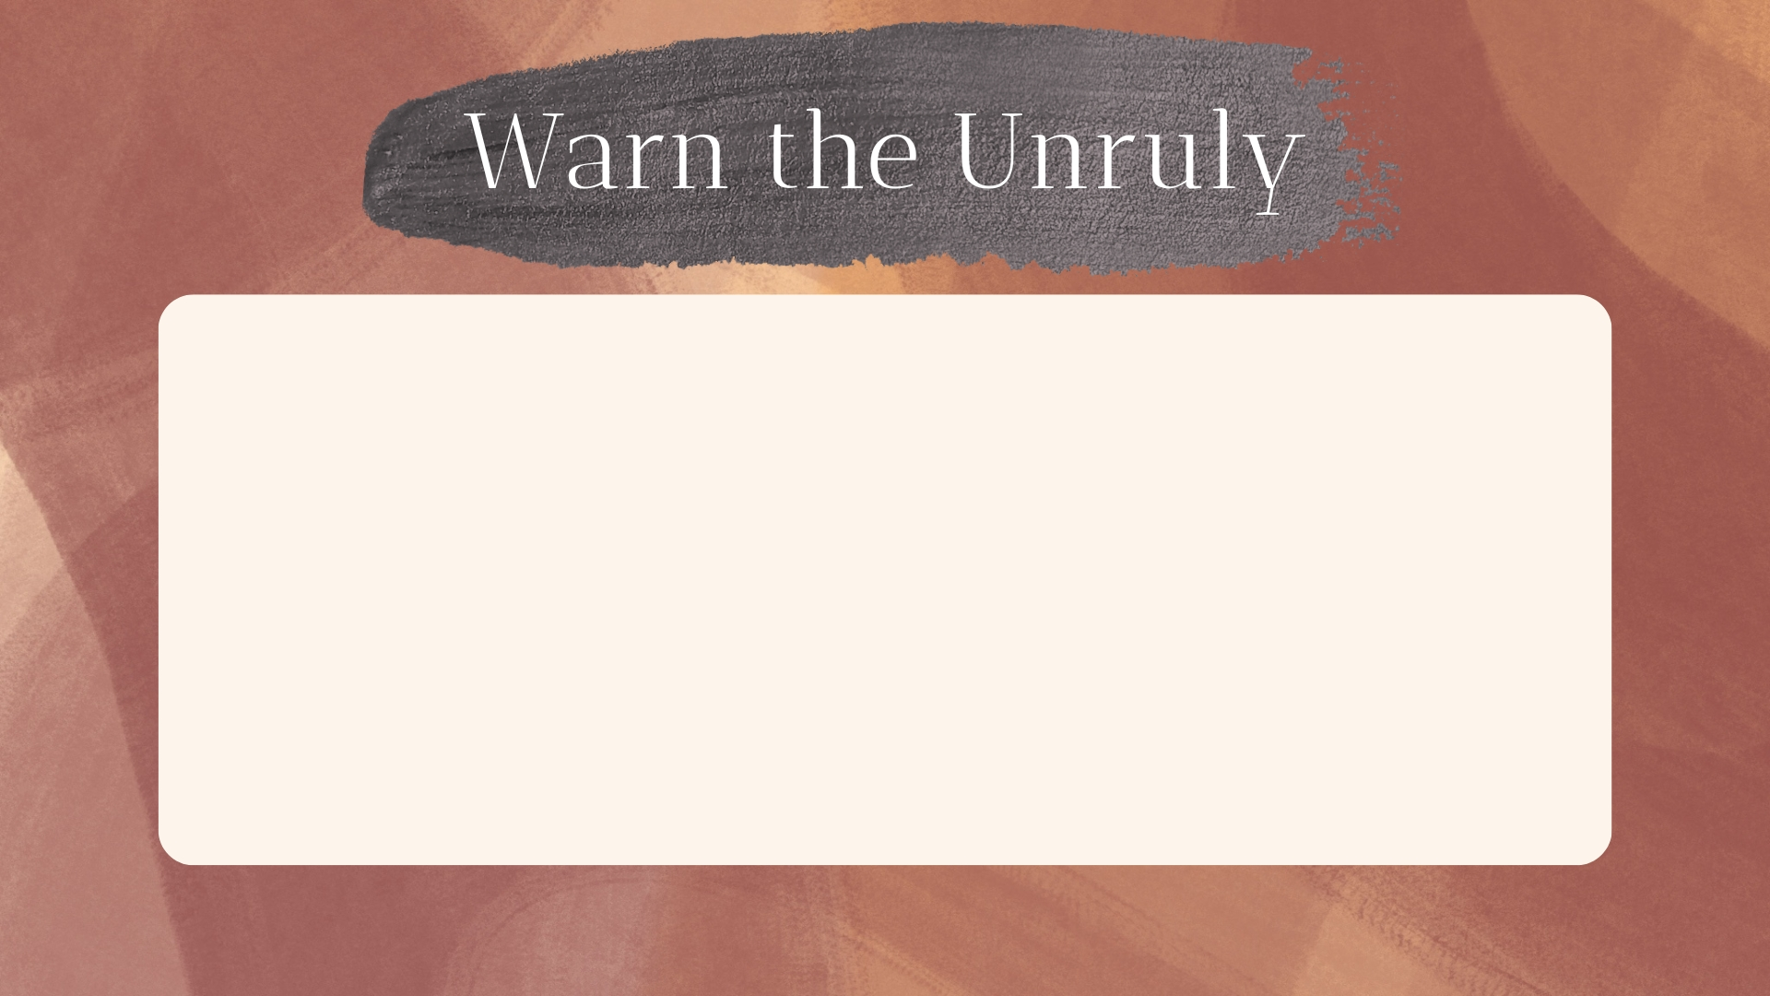
The unruly are to be warned – 1 Thessalonians 5:14
“deliver such a one to Satan” (1 Cor. 5:5) – not the first time they’re made aware they’re serving Satan – 2 Timothy 2:24-26
Matthew 18:15-17 – this is a process of warning.
Titus 3:10-11 – ample warnings given.

Slide 7
Establish Guilt
Warn Unruly
Practice Longsuffering

Slide 8
Longsuffering is a part of Christian character – Gal. 5:22; Col. 3:12; 2 Tim. 4:2; 1 Cor. 13:4 – certainly in church discipline.
Longsuffering – makrothymia – “state of being able to bear up under provocation, forbearance, patience” (BDAG)
Implies something is put off, but NOT inactivity.

Slide 9
God’s Longsuffering:
Toward Israel – Romans 2:4; 10:21; 2 Chronicles 36:15-17; Matthew 21:33-46
Generally – 2 Peter 3:9, 10, 14-15, 18
Longsuffering is NOT tolerance!

Slide 10
Longsuffering involves time, but time used scripturally and judged accurately – cf. Revelation 2:21
Not a matter of “how long is long enough,” but what is the quality of the time based on actions of the righteous (efforts to restore) and unrighteous (reasonable, rebellious, obstinate, moving toward repentance).

Slide 11
Example showing that “longsuffering,” among other things, is relative to the case:
“And have mercy on some, who are doubting; save others, snatching them out of the fire; and on some have mercy with fear, hating even the garment polluted by the flesh.” (Jude 22-23, NASB)

Slide 12
Longsuffering involves judgment, but the wrong, uniformed judgment lacking spiritual wisdom can lead to negligence, harm, and sin.
Longsuffering must not conflict with God’s call to exercise justice – 1 Corinthians 5:2

Slide 13
When thinking of the length of longsuffering, remember:
“Because the sentence against an evil work is not executed speedily, therefore the heart of the sons of men is fully set in them to do evil.” (Ecc. 8:11)

Slide 14
Establish Guilt
Warn Unruly
Practice Longsuffering
Inform Erring

Slide 15
The erring must be informed of the intent to withdraw from them – 1 Corinthians 5:5; 2 Thessalonians 3:14 – intended to save, bring shame, cause to repent.
Implies knowledge that the action is going to take place, and why.
Acts as a final warning to get him to repent.

Slide 16
Establish Guilt
Warn Unruly
Practice Longsuffering
Inform Erring
The Setting and Tone

Slide 17
Withdrawal is the “final step” when one has been given time to repent, but has not – Revelation 2:21; Matthew 18:17
It is to take place in the assembly – 1 Corinthians 5:4-5 (not first time to hear about it – cf. Matt. 18:17)
The tone should be commensurate with circumstance – 1 Corinthians 5:2

Slide 18
Establish Guilt
Warn Unruly
Practice Longsuffering
Inform Erring
The Setting and Tone
The Public Congregational Action

Slide 19
The action involves the whole church – Matthew 18:17 – public and congregational.
As Paul did in 1 Corinthians 5, the reasons for the action should be explained, as well as the responsibilities of the congregation.
NOTE: This may be a teaching opportunity for some who are not informed on church discipline.

Slide 20
Establish Guilt
Warn Unruly
Practice Longsuffering
Inform Erring
The Setting and Tone
The Public Congregational Action
No Fellowship

Slide 21
Not to have fellowship with darkness – Eph. 5:11; 2 Corinthians 6:14-16a
1 Corinthians 5:5 is an acknowledgment and reaction to what is already true – severed fellowship (cf. 1 John 1:5-6), serving Satan (cf. 2 Timothy 2:26).

Slide 22
Now that the relationship has changed, they are not to be treated in a way that implies fellowship, or tolerance of their sin:
Not members, not to be treated as members – Acts 9:26-28; 1 Tim. 2:8; Rom. 12:6-8; Rev. 2:20
Cannot share in evil by actions of tolerance – 2 John 9-11

Slide 23
Establish Guilt
Warn Unruly
Practice Longsuffering
Inform Erring
The Setting and Tone
The Public Congregational Action
No Fellowship
No Company

Slide 24
“But now I have written to you not to keep company with anyone named a brother, who is sexually immoral, or covetous, or an idolater, or a reviler, or a drunkard, or an extortioner—not even to eat with such a person.” (1 Corinthians 5:11)
“And if anyone does not obey our word in this epistle, note that person and do not keep company with him, that he may be ashamed.” (2 Thess. 3:14)

Slide 25
Establish Guilt
Warn Unruly
Practice Longsuffering
Inform Erring
The Setting and Tone
The Public Congregational Action
No Fellowship
No Company
Continual Admonition

Slide 26
“Yet do not count him as an enemy, but admonish him as a brother.” (2 Thess. 3:15)
May come by circumstantial opportunity.
May (and should) come by deliberate effort.

Slide 27
Establish Guilt
Warn Unruly
Practice Longsuffering
Inform Erring
The Setting and Tone
The Public Congregational Action
No Fellowship
No Company
Continual Admonition
Regular Remembrance

Slide 28
2 Thess. 3:15 implies that efforts should be taken to avoid them being forgotten.
How many congregations have forgotten about those they disciplined?
How many congregations make concerted effort to remember them?
Involves judgment, but measures must be taken!

Slide 29
Forgive and Comfort
Parable of the Unforgiving Servant – Matthew 18:21-35 – right after discussion on church discipline.
2 Corinthians 2:6-7 – they were instructed to forgive him.
Reaffirm Love (2 Corinthians 2:8; cf. Acts 2:46)
Rejoice (Luke 15:7, 10, 31-32)

