Slide 2
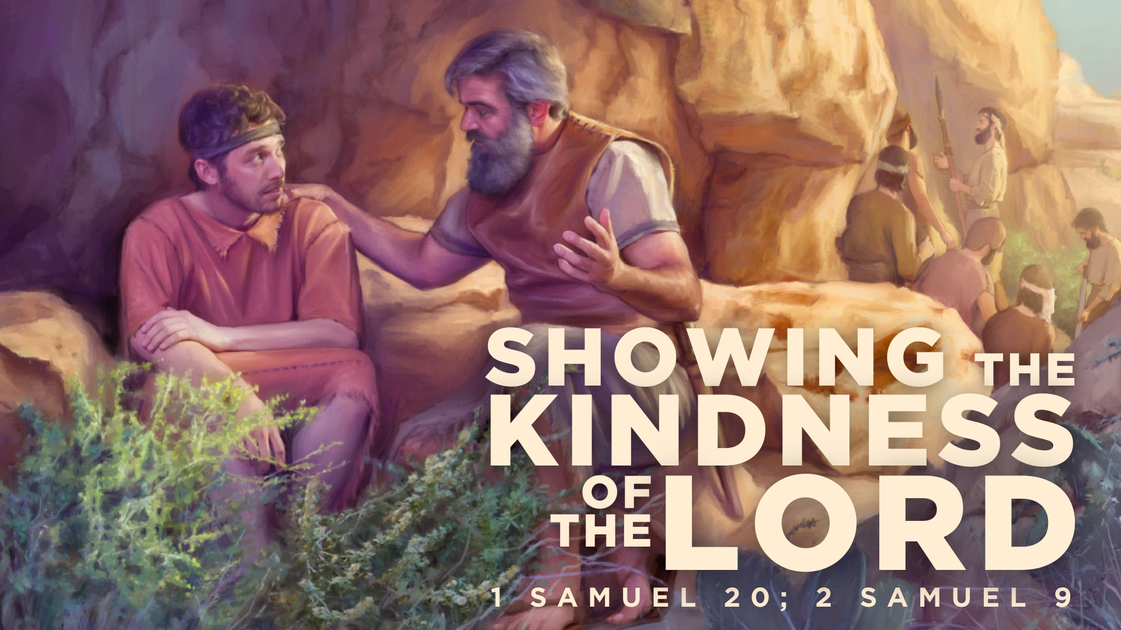

Slide 3
David Flees from Saul and Requests Kindness from Jonathan – 2 Samuel 20:5-8
“kindly” “lovingkindness” (LSB) – hesed – “(1) joint obligation between relatives, friends, host and guest, master and servant; closeness, solidarity, loyalty…(1a)…faithfulness; to show loyalty” (HALOT)
LXX – eleos – “kindness or concern expressed for someone in need, mercy, compassion, pity, clemency” (BDAG)
Love, compassion, mercy, kindness that is faithful and loyal.

Slide 4
The Friendship of Jonathan and David
Jonathan’s soul knit to David’s after witnessing victory, and hearing humble interaction with Saul – 1 Samuel 17:55-18:4
Affected Jonathan this way due to their mutual faith in, and love for God – cf. 1 Samuel 14:6, 46
“like precious faith” (2 Peter 1:1) leads to a covenant of love, kindness, and loyalty – John 17:20-23; 1 Peter 1:22; 1 John 4:11; 5:1-2

Slide 5
Jonathan to David
The request and following plan – 1 Samuel 20:8-11, 18-23
Jonathan comes to know his father’s true intentions, and keeps covenant with David – 1 Samuel 20:30-33; 23:16-18
David to Jonathan
Jonathan’s request for David to show him the kindness of the Lord – 1 Samuel 20:14-17

Slide 6
The Kindness of the Lord
“show me the kindness of the Lord” (1 Samuel 20:14).
We learn this kindness from the Lord – Exodus 34:6-7; Ezra 3:11; Psalm 136
Jonathan’s request shows faith that God is with David, and appeals to David to be a channel of God’s kindness to him when David is blessed – 1 Samuel 20:14; 23:17
We receive God’s kindness to show it to each other – Ephesians 4:15-16, 25, 32; 5:1-2; 1 John 3:16-17

Slide 7
David Seeks to Keep His Covenant with Jonathan
(2 Samuel 9)
(vv. 1-5) – does one from Saul’s house remain?
(vv. 6-8) – Mephibosheth, only remaining son of Jonathan, humbly presents himself before David.
(vv. 7, 9-10, 13) – David shows the kindness of the Lord. (cf. v. 3; 2 Samuel 4:4)

Slide 8
David Seeks to Keep His Covenant with Jonathan
(2 Samuel 9)
David didn’t know Mephibosheth, but it didn’t matter. The kindness of the Lord surpasses time and circumstance. It is loyal, and faithful.
This is the love and kindness we are to show – Micah 6:8

