Slide 2
Salvation from Captivity
Exodus 3:7-8, 14-15; 14:13, 30-31; 1 Corinthians 10:1-5
Internal Conflict
Exodus 15:24; 16:2-3; 17:3, 7; Philippians 2:12-16
External Conflict
Exodus 17:8-16; 1 Samuel 15:1-3; Deuteronomy 25:17-19; Numbers 24:30; Ephesians 6:10-13; 1 Peter 5:8

Slide 4
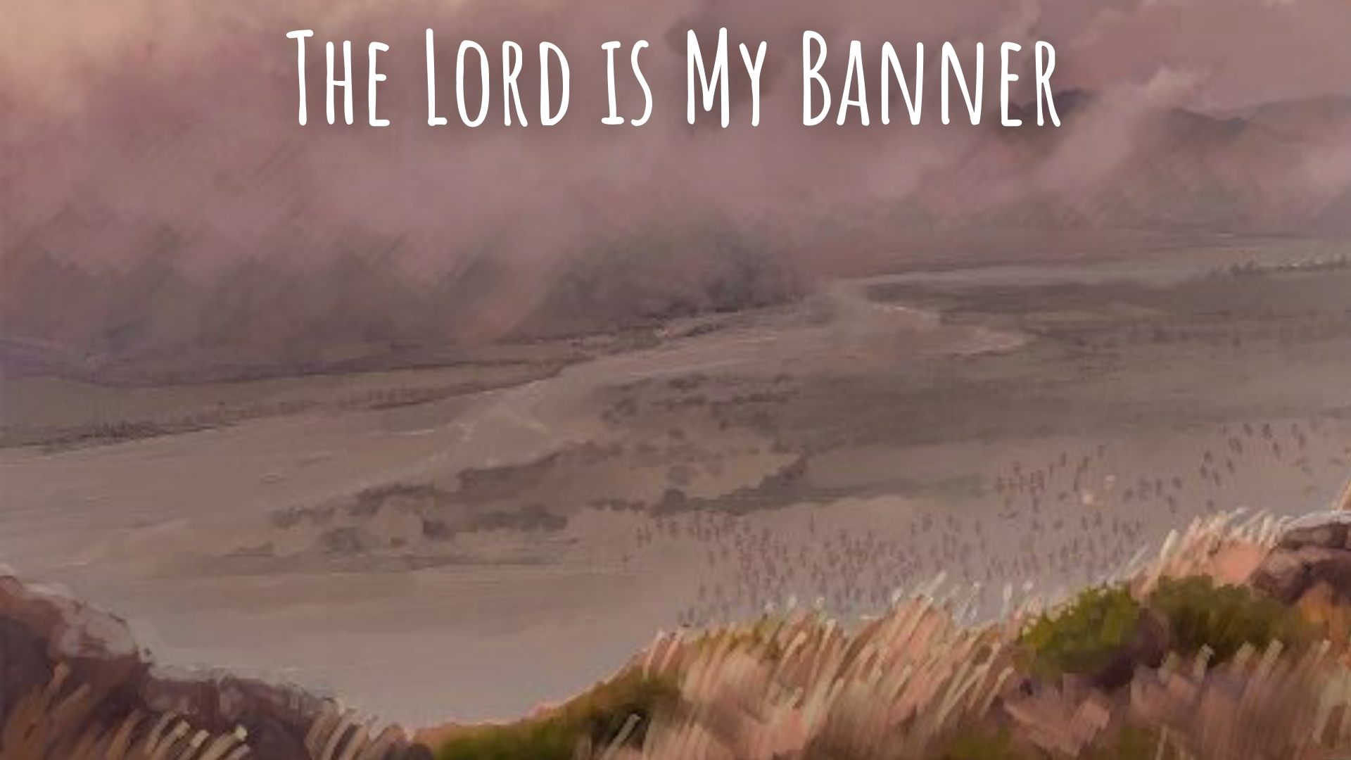
Prayer
Moses lifted up his hands with the rod and Israel prevailed – Exodus 17:9, 11 (cf. Exodus 4:17, 20; 14:16, 21)
Lifting up hands in prayer – Psalm 28:2; 134:2; 141:2; Lamentations 3:40-42; 1 Timothy 2:8
The Lord is our banner, but it is through petitioning Him in prayer that He is moved to act – Ephesians 6:18; James 1:5; 1 Peter 5:6-7; Luke 18:1, 8; James 5:16

Slide 5
Support of Leaders
Aaron and Hur helped support Moses’ hands – Exodus 17:10-13
God tells us to hold up the hands of those who lead us – Acts 14:23; 1 Thessalonians 5:12-13; Hebrews 13:7, 17

Slide 6
The Root of Jesse
The Messiah, a Root of Jesse, “a Rod from the stem of Jesse,” stands as a banner to the spiritual remnant, including Gentiles – Isaiah 11:10-16
The Lord is our victory – 2 Timothy 4:17-18

